Slide 1
FRACAS: An Essential Ingredient for Reliability Success

Slide 2
Agenda
Introduction
Vocabulary
Define FRACAS
System Integration
Case Study 1
Case Study 1
Summary
Questions

Slide 3
Introduction
Adamantios Mettas
Vice President of Business Development at HBM Prenscia.
20 years of experience in reliability tools and methods, researching, lecturing, designing, delivering and implementing Reliability and Asset Performance Management solutions worldwide.
More than 35 publications in journals and proceedings, co-authored 4 books, and trained more than 2000 engineers in reliability methods.
Directly involved as a Project Manager, Implementation Manager, and Primary Consultant/Analyst in major Design for Reliability and Asset Performance Management projects/initiatives worldwide and across different industries, including Oil & Gas, Power Generation, Automotive, Rail, Semiconductor, Defense and Aerospace, and for clients such as XEROX, DELPHI, FORD Motor Company, VOLVO Cars, Chevron, Kuwait Oil Company, Ma’aden Phosphate Company, and others.
Tearesa Wegscheid
Sr. Reliability Solution Consultant at HBM Prenscia.
Involved in product engineering for over 33 years, including statistical analysis, reliability testing and data analysis, and quality control.
Provided training Certified Reliability/Quality Engineering exam, the use of FMEA in the product development cycle, quality control techniques, life data analysis, and Design for Reliability.
B.S. from Western Michigan University in Experimental Psychology and Computer Science. M.S. in Computer Science, Educational Leadership and Manufacturing & Industrial Engineering.
Certified Reliability Engineer (ASQ) and a Certified Quality Engineer (ASQ). She is also a Certified Reliability Professional (CRP).

Slide 4


Introduction (cont’d)
Fixed Assets
Fleet
Problem
Problem
Reactive maintenance – not understanding the root cause
High maintenance costs – lessons learned not captured
Not able to compute asset KPIs – Maximo data non-usable
High “flaring” (i.e. production losses)
Non-optimized maintenance strategies
Currently issues / failures tracked in SAP but not configured to:
  Manage issues / failures
  Identify problems
  Assign, implement, manage & report problem resolution process
  Calculate & track reliability KPIs
  Link to RCM
Difficult to compute KPIs
  Current maintenance plans time-based (not mileage)
  Unable to fully utilize failure / maintenance data
  Labor intensive (hours for single system, days for multiple systems)
Notes:
Gas and Oil – Reduced Flaring – reduce emissions, increase gas supply, improve resource use effectiveness.
Point – either with fixed assets or with fleets → problem with maintenance and addressing failures/problems effectively → recurring failures and loss of money. We want to be able to address these issues.

Slide 5
Vocabulary
CAPA – Corrective Action Preventive Action
CMMS – Computerized Maintenance Management System
DCS – Distributed Control System
ERP – Enterprise Resource Planning
EAM – Enterprise Asset Management (similar to CMMS)
FA – Failure Analysis
FMEA – Failure Mode and Effects Analysis
Historian - Capture instrumentation and control data
KPI – Key Performance Indicators
MDBF – Mean D? Between Failures
MDBSF – Mean D? Between Significant Failures
MTFB – Mean Time Between Failure
MTBI – Mean Time Between Incident
MTBCF – Mean Time Between Critical Failure
MTBNCF – Mean Time Between Non-critical Failure
MTTR – Mean Time to Repair
RBD – Reliability Block Diagrams
RCM – Reliability Centered Maintenance
RGA – Reliability Growth Analysis
SAP – System Applications and Products in Data Processing (ERP software)
W.O. – Work Order
W.N. – Work Notification

Slide 6
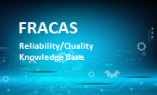
FRACAS Definition
Failure Reporting, Analysis and Corrective Action System (FRACAS) is a closed-loop feedback path used to collect, record, analyze and correct failures
The fundamental characteristics of FRACAS are:
  Recording and capturing failures and problems
  Identifying, selecting and prioritizing failures and problems
  Identifying, implementing and verifying corrective actions to prevent recurrence of failures
  Providing failure analysis and corrective action information to support reliability data analysis
  Providing report summaries of incidents counts and reliability and quality metrics
Reliable Products
Analysis & Problem Management
Incident Reporting
Corrective Action
Notes:
Application below are based on some portions of the general FRACAS methodology
CAPA Systems
Safety/Risk Systems
Process Control Systems
Incident Reporting Systems
Etc.…

Slide 7
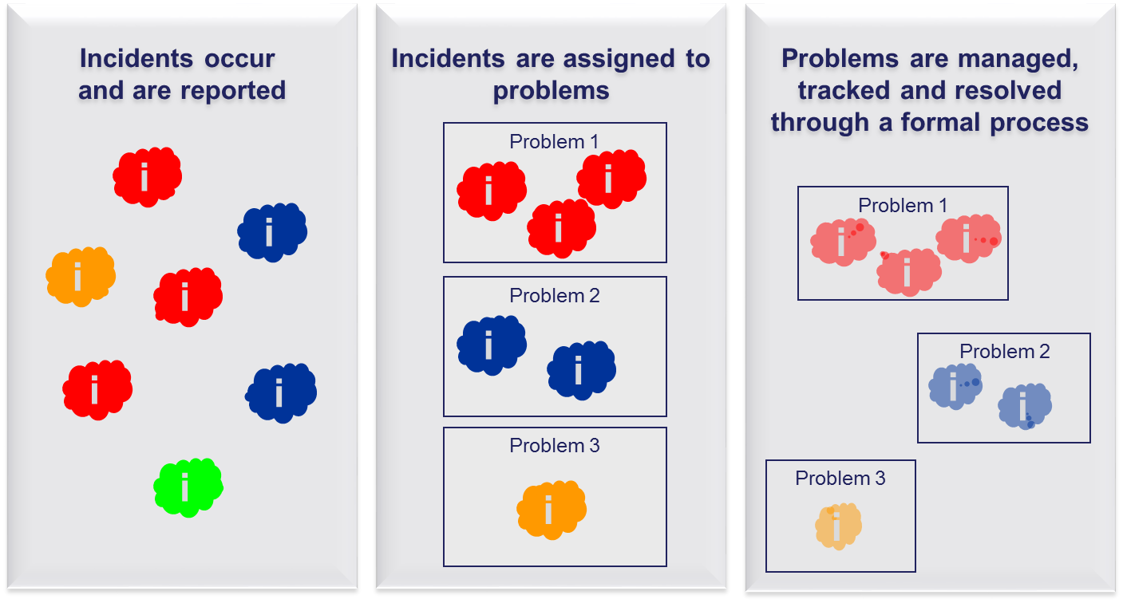

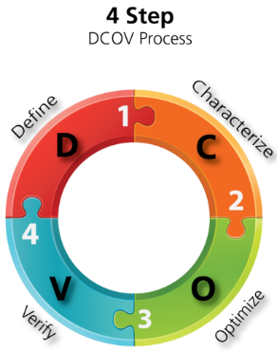
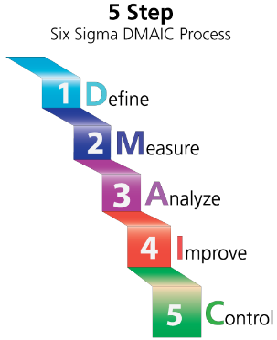
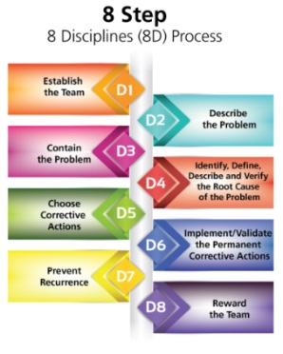
FRACAS Definition (cont’d)
MANY INCIDENTS…..SAME PROBLEM?
Facilitates more in-depth analysis and team-based problem resolution for broader underlying issues.

Slide 8
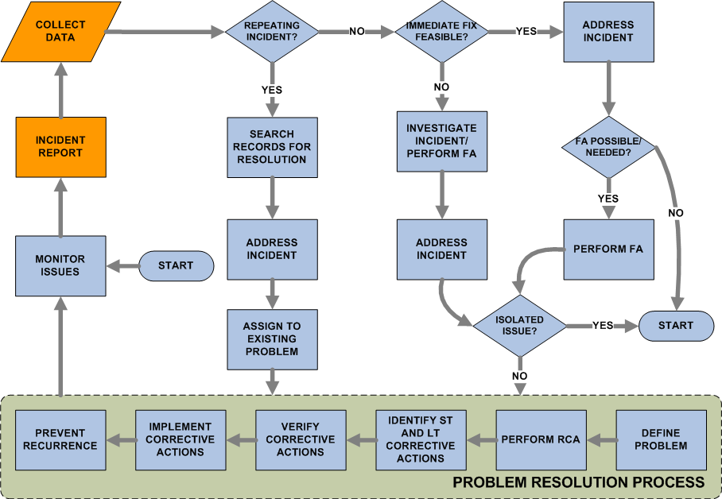
FRACAS Definition (cont’d)
FRACAS WORKFLOW

Slide 9

Benefits of FRACAS
Facilitates reporting and resolution of downing events and interruptions to production – problem resolution
Eliminates the reliance on inefficient,
non-integrated ways of reporting problems – streamlines reporting
Compiles a log of problems caused by suppliers’ equipment – tracking supplier quality and reliability
Provides a formal process for problem resolution
Supports Reliability analytics – equipment insight
Supports Reliability Centered Maintenance activities – maintenance optimization

Slide 10
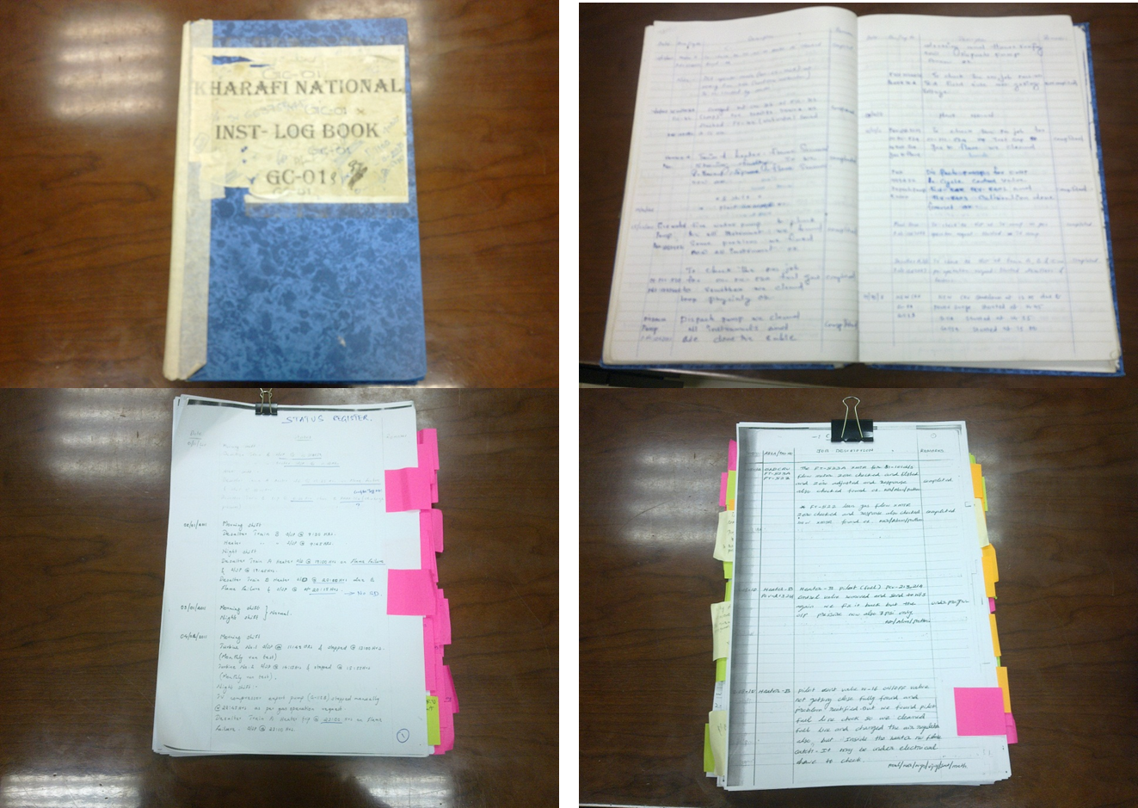

Today’s Challenge
20 Years ago the challenge was data
Today, the challenge is…still data
How to Process and Clean Data
Unstructured
No Context

Slide 11

Today’s Challenge (cont’d)
FRACAS is not a stand-alone system
Multiple system providing input to FRACAS process
Increase in the number of stakeholders – sharing the information
Linkage to other information: Reliability Engineering
RCM/FMEA/FMECA

Slide 12





How to Process and Clean Data
Asset Analytics
ERP / CMMS
W.N.
Verify
Qualify
Add Context
Criticality
W.O.
FRACAS
Failure Rate
X
Unstructured
Historian
Notifications
and Usage
Remaining Life
Analysis Results and/or verified event
Training
X
No Context
Time Series Data
Signal Processing / Pattern Recognition / ML
Signal cleanup
Pattern Recognition
Anomaly detection and removal
Damage Analysis
Drift correction
© 2018 HBM Prenscia Inc.
Notes:
There must be some intermediate step to vet
Training the system by adding context to eventually automate the whole process

Slide 13
FRACAS Link to Reliability
Engineering Methods
FRACAS drives future FMEAs, as well as provide information for reliability data analysis, such as:
  Number of failures, incidents, chargeable failures, non-chargeable failures and survivors
  Defects per unit, per batch or per process
  Failure/suspension times
  MTBF, MTBI, MTBCF, MTBNCF
  Operational availability
  Maintenance/repair costs per unit time
  Downtime for service, repair, etc.

Slide 14
Case Studies
Fixed Assets
Fleet
Problem
Problem
Reactive maintenance – not understanding the root cause
High maintenance costs – lessons learned not captured
Not able to compute asset KPIs – Maximo data non-usable
High “flaring” (i.e. production losses)
Non-optimized maintenance strategies
Currently issues / failures tracked in SAP but not configured to:
  Manage issues / failures
  Identify problems
  Assign, implement, manage & report problem resolution process
  Calculate & track reliability KPIs
  Link to RCM
Difficult to compute KPIs
  Current maintenance plans time-based (not mileage)
  Unable to fully utilize failure / maintenance data
  Labor intensive (hours for single system, days for multiple systems)

Slide 15
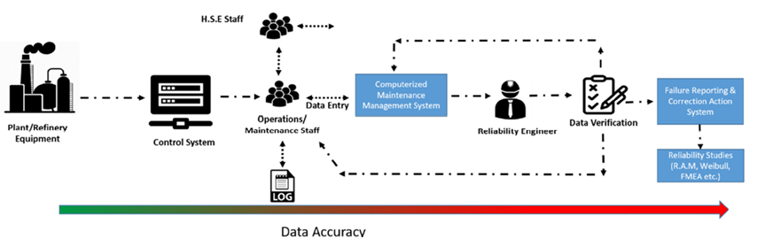
Case Study 1
Data Quality & Confidence
  The quality of the data is correlated directly reliability study outputs
The three main issues faced in data quality and confidence were:
  Lack of standardized source of information
    Reliability data was spread over several different systems
  Data Saturation
    Huge influx of data without proper structure to manage and filter data
  Personnel Competence and Motivation
    Due to poor data collection infrastructure, staff would be spending too much time on data collection and verification; making data collection a repetitive and tedious job
Sarah A. Khuraibet, Management of Critical Equipment Reliability Data in Oil & Gas Plants through Digitalization, 2019 ARDC Europe

Slide 16
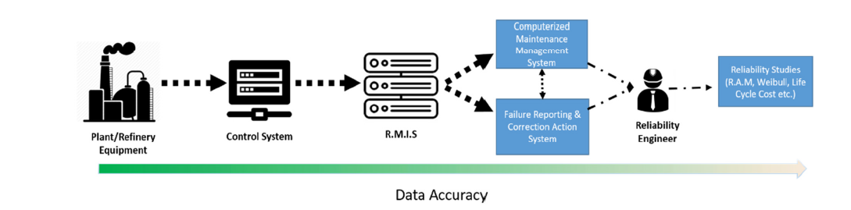
Case Study 1 (cont’d)
Reliability Management Information System (RMIS)
  Automated real-time equipment data collection & validation
    Capture of failures that required repair action and failures that did not require repair actions
    Distinguish between failures and equipment that is on standby or manually shutdown
  Real time data reporting and equipment reliability
  Integrated all reliability and maintenance software
RMIS was integrated with FRACAS system to automatically generate incidences
Information from FRACAS was exported to other RCM and reliability analysis tools
Sarah A. Khuraibet, Management of Critical Equipment Reliability Data in Oil & Gas Plants through Digitalization, 2019 ARDC Europe

Slide 17
Case Study 1 (cont’d)
Results
  Significant time reduction in data gathering and verification
  Reliability Technicians are used more efficiently
  Origin of data is documented and traceable
  Higher quality of data by reducing human error
  Improved reliability studies
Problem
Solution
Value
Reactive maintenance – not understanding the root cause
High maintenance costs – lessons learned not captured
Not able to compute asset KPIs – Maximo data non-usable
High “flaring” (i.e. production losses)
FRACAS integrated with DCS
Improved failure data collection process
Link to Reliability methods
Robust monitoring and reliability analyses increased output and minimized financial losses resulting in $110M of savings over 5 years.
Positive environmental impact - “reduced flaring”
Regulatory requirements compliance
Sarah A. Khuraibet, Management of Critical Equipment Reliability Data in Oil & Gas Plants through Digitalization, 2019 ARDC Europe

Slide 18

Case Study 2
Fixed Assets
Fleet
Problem
Problem
Reactive maintenance – not understanding the root cause
High maintenance costs – lessons learned not captured
Not able to compute asset KPIs – Maximo data non-usable
High “flaring” (i.e. production losses)
Non-optimized maintenance strategies
Currently issues / failures tracked in SAP but not configured to:
  Manage issues / failures
  Identify problems
  Assign, implement, manage & report problem resolution process
  Calculate & track reliability KPIs
  Link to RCM
Difficult to compute KPIs
  Current maintenance plans time-based (not mileage)
  Unable to fully utilize failure / maintenance data
  Labor intensive (hours for single system, days for multiple systems)

Slide 19
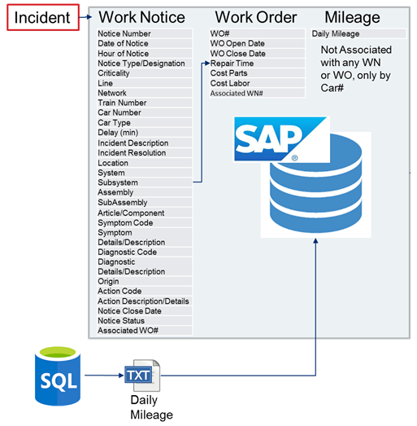
Case Study 2 (cont’d)
Current Environment

Slide 20
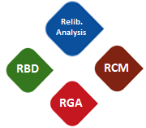
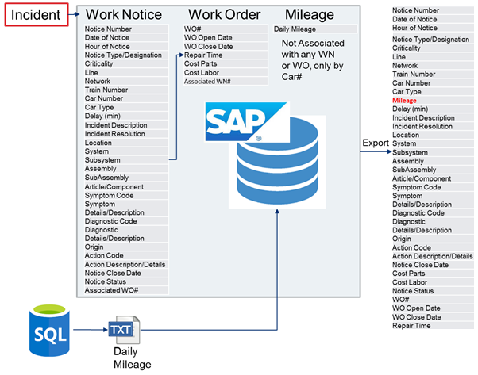
Case Study 2 (cont’d)
Integration of FRACAS
FRACAS
Problem Resolution Process (8D)
Report:
MDBF
MDBSF
MTTR
Line
Car Type
System
Component

Slide 21
Case Study 2 (cont’d)
Value - Fleet Management
Problem
Solution
Value
Non-optimized maintenance strategies
Currently issues / failures tracked in SAP but not configured to:
  Manage issues / failures
  Identify problems
  Assign, implement, manage & report problem resolution process
  Calculate & track reliability KPIs
  Link to RCM
Difficult to compute KPIs
  Current maintenance plans time-based (not mileage)
  Unable to fully utilize failure / maintenance data
  Labor intensive (hours for single system, days for multiple systems)
FRACAS linked to SAP and Operational data, structured architecture:
  Interfaced daily with SAP to retrieve incidents
  Interfaced with Operational data to retrieve mileage
  Usage / mileage / time based reliability calculations
  Predefined reports
  “Off line” analytic tools for advanced modeling and “what-if” scenario investigations – “trade space”
Easily identify and address emerging problems
Track impact of improvements
Reliability calculations based on appropriate metric (usage)
Reduced analysis time to seconds:
  Ease of identifying problems
  Allows engineers to focus on identifying & resolving problems, rather than data extraction & formatting
Ease of access to results / reports for stakeholders
Overall higher fleet availability and reduced downtime
Scalable framework to implement process for problem investigation & resolution
Assess & optimize maintenance / operational strategies

Slide 22
Summary
Drives reliability improvement throughout the asset lifecycle:
  Capital equipment installation – reduce costs & time
  Identify and eliminate chronic issues
Provides Context and improves data quality
  Provides a knowledge base of lessons learned
  Provides engineering data for corrective and
  preventive actions
  Provides failure data for
  reliability analytics
Establishes a formal process followed by the
entire organization
  Traceability
  Regulatory Compliance
  Auditing
  Data Culture
  Reliability Culture
1
2
3

Slide 23
Thank you for your attention
Questions

