Slide 1
Projects in Prognostics and Predictive Analytics

Slide 2
Agenda
Introduction
Vocabulary
Advantages of advance analytics
Implementation of advance analytics
Examples
Summary
Questions

Slide 3
Introduction
Adamantios Mettas
Vice President of Business Development at HBM Prenscia.
20 years of experience in reliability tools and methods, researching, lecturing, designing, delivering and implementing Reliability and Asset Performance Management solutions worldwide.
More than 35 publications in journals and proceedings, co-authored 4 books, and trained more than 2000 engineers in reliability methods.
Directly involved as a Project Manager, Implementation Manager, and Primary Consultant/Analyst in major Design for Reliability and Asset Performance Management projects/initiatives worldwide and across different industries, including Oil & Gas, Power Generation, Automotive, Rail, Semiconductor, Defense and Aerospace, and for clients such as XEROX, DELPHI, FORD Motor Company, VOLVO Cars, Chevron, Kuwait Oil Company, Ma’aden Phosphate Company, and others.
Tearesa Wegscheid
Sr. Reliability Solution Consultant at HBM Prenscia.
Involved in product engineering for over 33 years, including statistical analysis, reliability testing and data analysis, and quality control.
Provided training Certified Reliability/Quality Engineering exam, the use of FMEA in the product development cycle, quality control techniques, life data analysis, and Design for Reliability.
B.S. from Western Michigan University in Experimental Psychology and Computer Science. M.S. in Computer Science, Educational Leadership and Manufacturing & Industrial Engineering.
Certified Reliability Engineer (ASQ) and a Certified Quality Engineer (ASQ). She is also a Certified Reliability Professional (CRP).

Slide 4



Introduction (cont’d)
Objectives:
  Increase useful life
  Prevent premature failure
  Reduce operations and maintenance costs
Challenges:
  Cost of data collection, not having enough of the right data
  Getting independent, actionable insights as the outcome
  Scalability
Key enablers:
  Physics of Failure
  “AI” Basis for predictive and prescriptive maintenance
  Information and Operation Technologies
  Cloud Technologies

Slide 5
Vocabulary
AI – Artificial Intelligences
CMMS – Computerized Maintenance Management System
EAM – Enterprise Asset Management
ERP – Enterprise Resource Planning
FMEA – Failure Modes and Effects Analysis
RAM – Reliability Availability, Maintainability
RCM Reliability Centered Maintenance
PM – Preventative Maintenance
PdM – Predictive Maintenance
PxM – Refer to various types of preventative maintenance

Slide 6



Operational Monitoring
Operational – functional, going, in working order, operative, prepared, ready, up and running, usable, viable, workable, working
  Capable of, needed in or actually involved in operations
Monitoring – a person or piece of equipment that warns, checks, controls, or keeps a continuous record of something
Operational Monitoring
  Collecting key system performance metrics at periodic intervals over time
  Operation monitor has a means for selecting multiple simultaneously operable component mounting devices
  Operational monitoring practices focus on critical control points in the system to ensure the system is being operated as required

Slide 7
Value at Stake
How can asset data help reduce operating costs?
Early warning: Planned intervention and avoiding in-field failures
  Driveshaft damage using Inferential Sensing
  Bearing fault detection
  Remaining useful life prediction for turbo chargers
Avoid over and under-maintaining: Optimize total cost of ownership
  Engine oil change intervals optimized
Improved usage & operation: Visibility of the impact of usage on the remaining useful life of expensive components
  Transfer case damage due to driver behavior
Reduced or less costly inspections: Using sensors instead of manual inspections
  Structural gates
Design Improvements: Drive design improvements by understanding usage and operating conditions
Operating costs can be reduced by utilizing asset data for more proactive maintenance
6% or more reduction in operating
costs

Slide 8
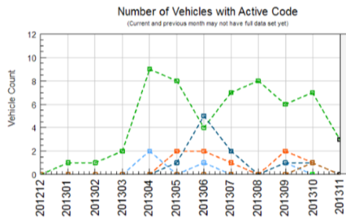
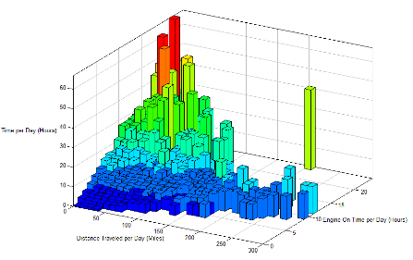
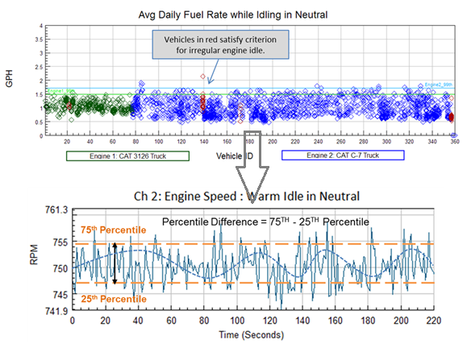
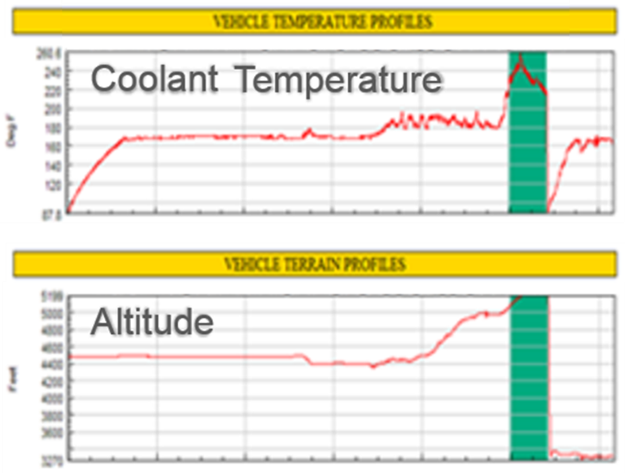
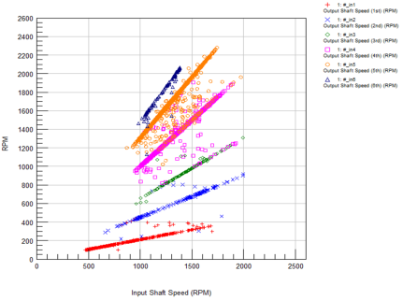
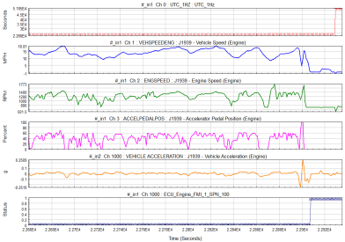
Insights… Deliver Actionable Information
Fleet level and asset / equipment level analysis that can help reduce operating and maintenance costs
Notional Data
Fleet Level Analysis
Improve Fleet Availability
Identify Systematic Issue
Schedule Services
Manage Scheduled Services
Fault Trending
Measure Usage Profiles
Divestiture Candidates
…
Equipment Level Analysis
Equipment Heath Issues
Design Spec. Exceedances
Accident Investigation
…

Slide 9
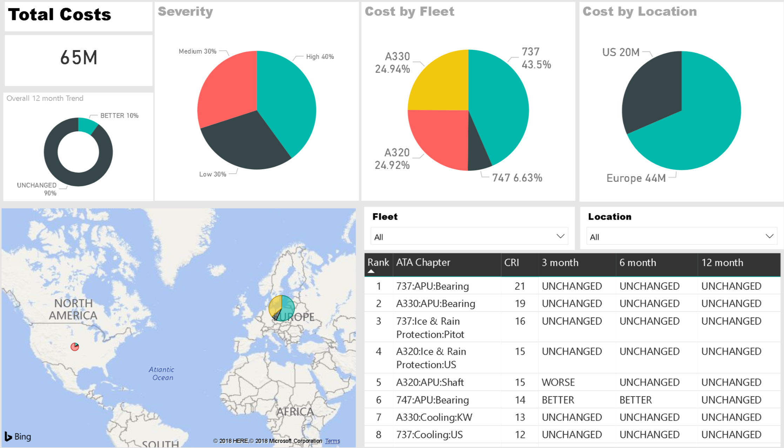
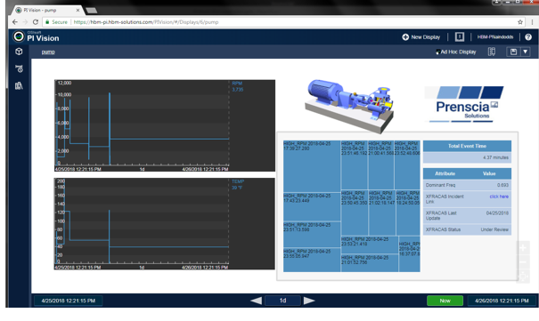
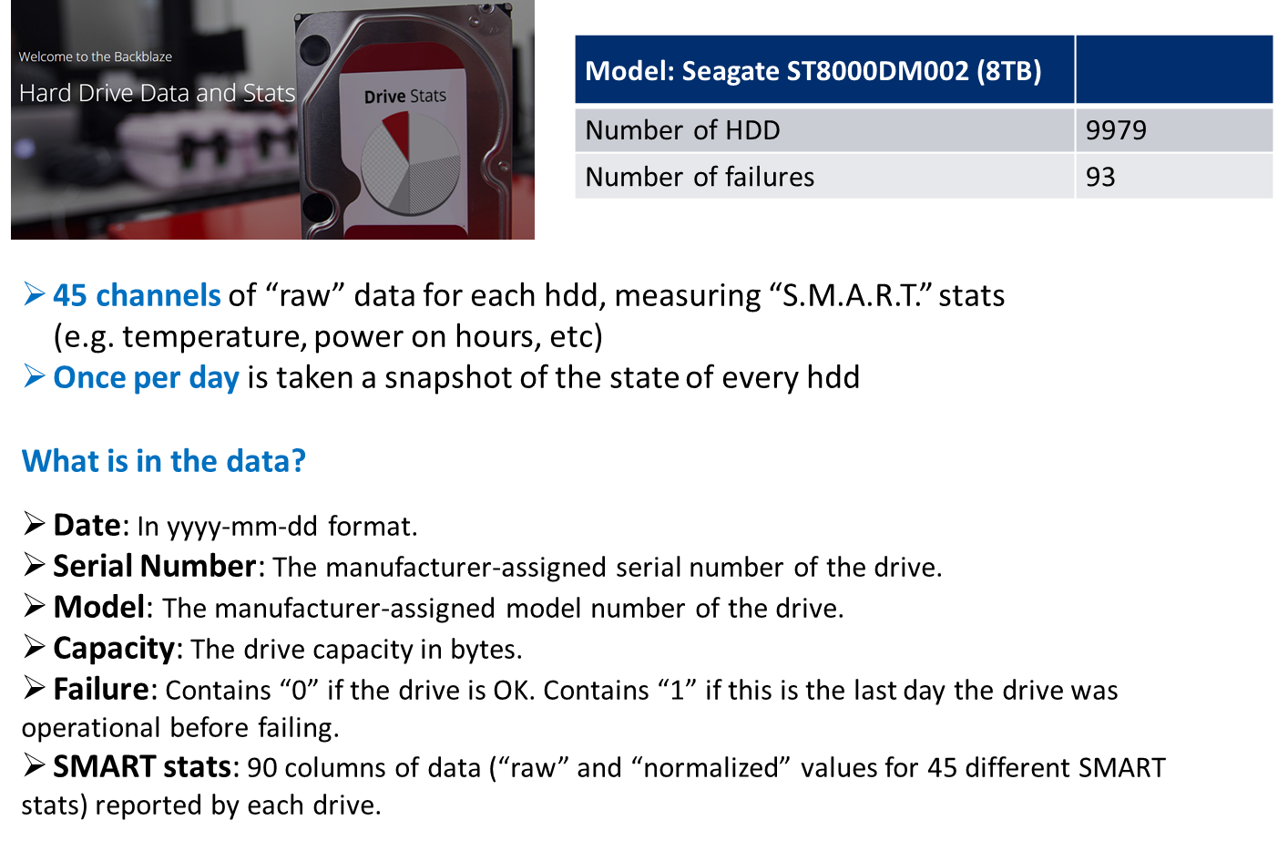
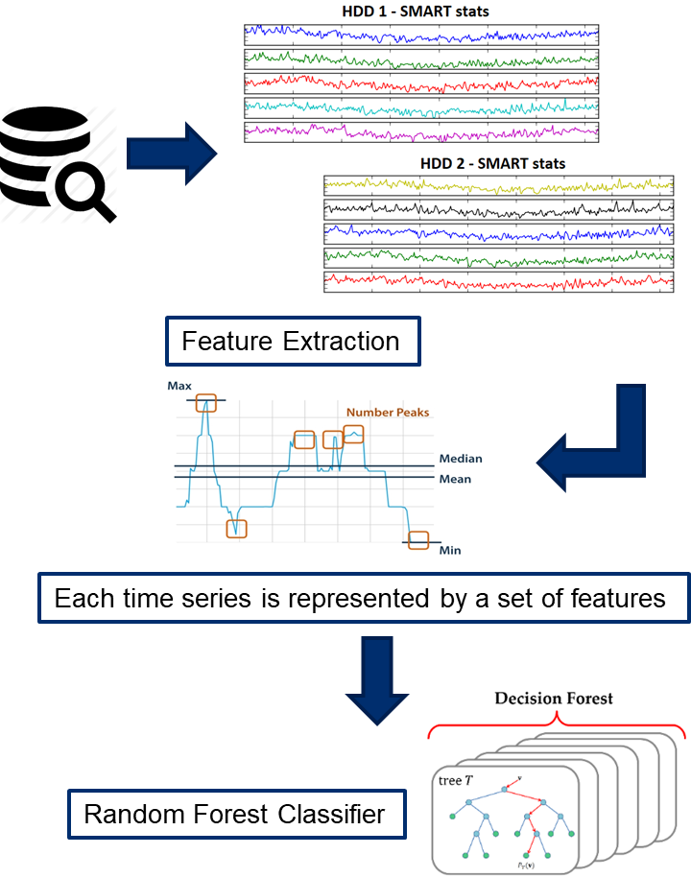
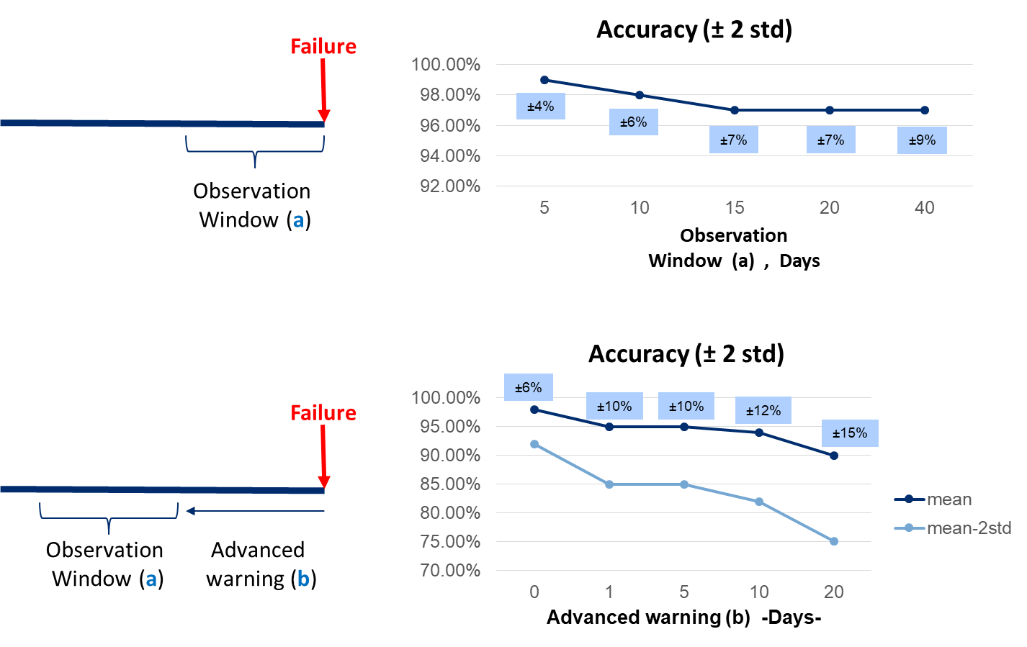
Integrating Operational and Maintenance
Data for Prognostics and Diagnostics
Link with Maintenance Data
Link with Operational Data
Machine Learning
Example

Slide 10
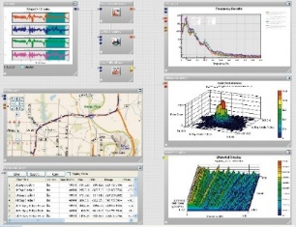

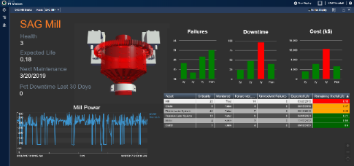
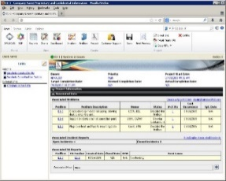
Combine Operational Data with Historical
Data for Superior Insights
Signal Processing: Vibration, Usage, Derived Analytics, Machine Learning
Historian
Virtual Twins,
Virtual Operations
Operational Data
Usage Data
CMMS/ERP
Historical Failures
Superior Insights,
Remaining Life, Expected Life,
PdM, PxM
Reliability Strategy and Analysis: FMEA, RCM, Weibull, RAM, Asset Investment Simulations, Incident Tracking, Root Cause Analysis

Slide 11
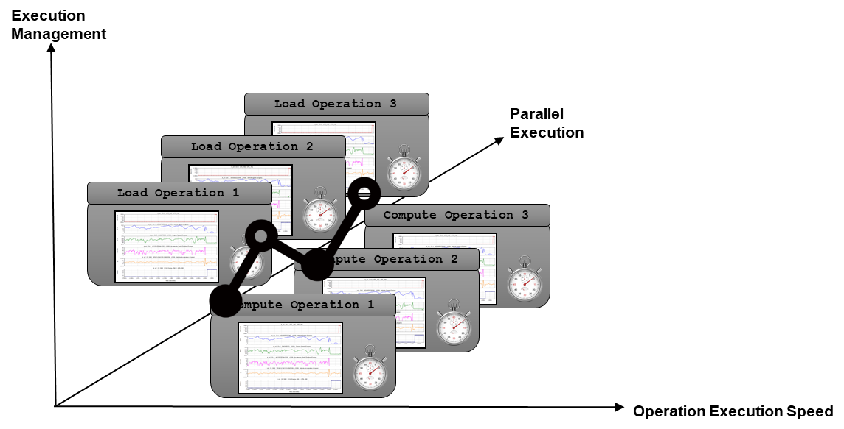
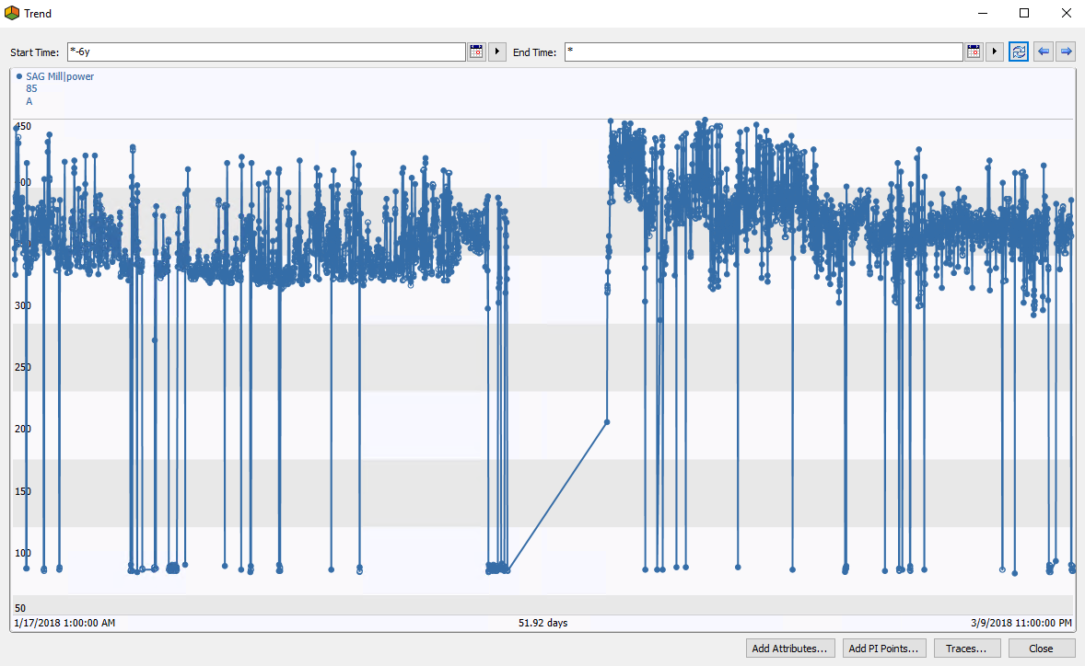
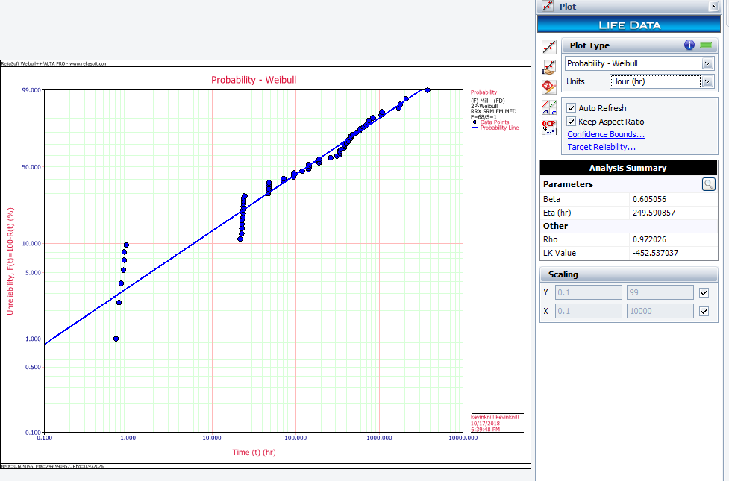
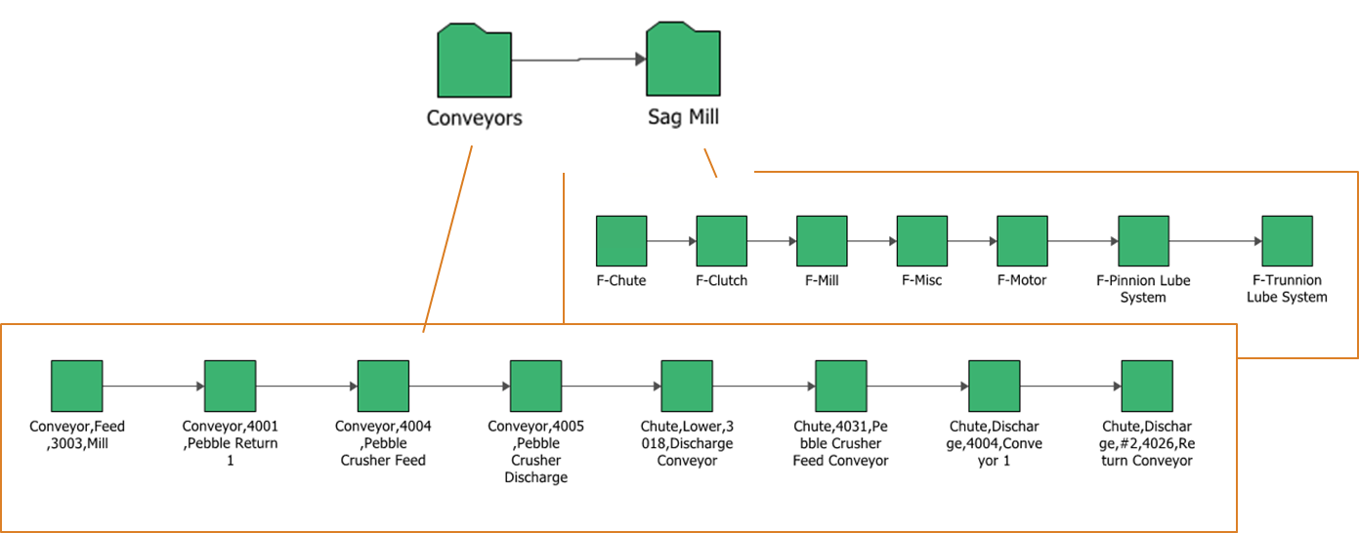
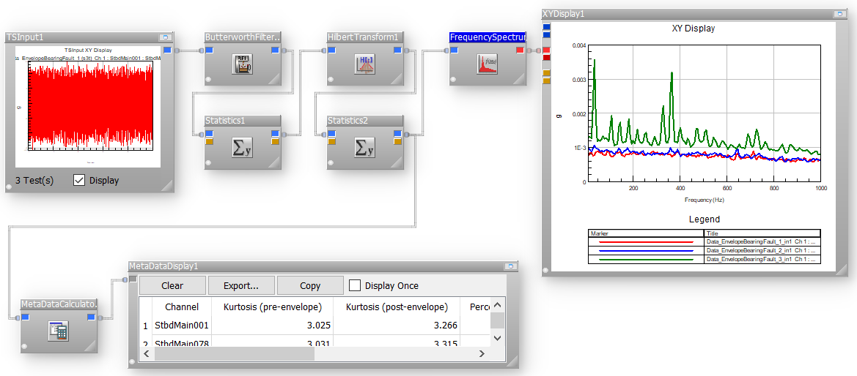
Example
Data Preparation
  Optimize Data Upload
  Optimize Data Processing
  Organize and Structure Data (Data Conditioning)
  Remove bad data points
Load data into Historian
  Asset structure for equipment components
  Create tags from sensor data
Create models
  Incidents created from unplanned trips
  Component life models built from incidents
  Deterioration models built from operational data
  Remaining Life models built by combining both models

Slide 12
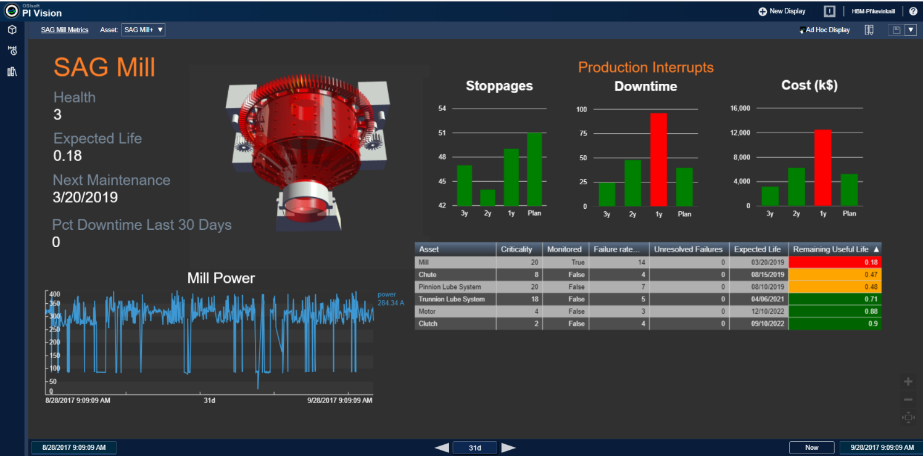
Example (cont’d)
Automation/Real-time Insights
Sample Dashboard with multiple derived KPIs (built on OSISoft Technology)

Slide 13


Approach
End-to-end approach that is flexible and overcomes data constraints by combining engineering/physics and AI
Advantages
By incorporating usage severity at the heart of analytical workflow enables models to be flexible to industry, operating environments and usage behavior
Costly data requirements are reduced by using subject matter expertise to
  Define key data requirements early on
  Enrich data with engineering/physics models prior to AI
Define focus area
Define
key parameters
Method to estimate usage severity
Configure analysis algorithm
Analyze subset of data
Perform Predictions
Validate with field performance
Refine and automate for scalability
Productize automated analysis algorithm
SME/Engineering
AI/ML

Slide 14
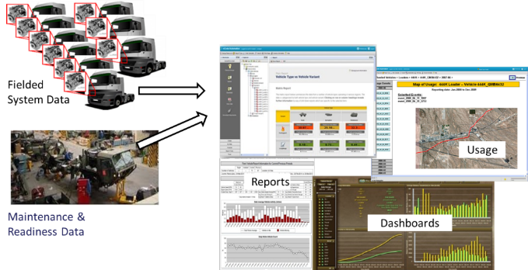
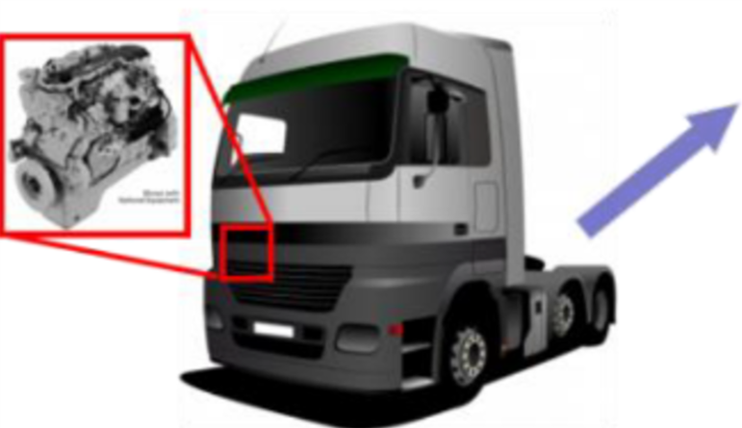
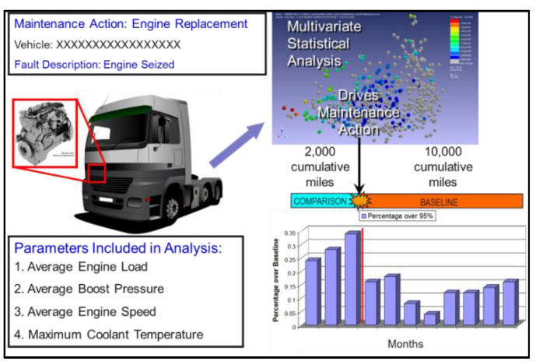
Case Study – Off-Highway Vehicle Fleet
Advanced Analytics scaled to 2,000 vehicles in a multi-OEM fleet
Challenge
Off-Highway Vehicle – Advanced Analytics
Approach
Reduce lifecycle costs by utilizing asset data
Predict asset health and remaining useful life of components – improve maintenance readiness & logistics
Scale asset analytics solution to thousands of vehicles
Delivered operating performance metrics (e.g. idle time, fuel use)
Utilized machine learning techniques combined with physics models to predict Remaining Useful Life of key components
  E.g. Turbocharger, transfer case, driveshaft, engine oil etc.
Scaled to 2,000 vehicles and implemented a fleet monitoring center
Results
$15m Annual Savings
Annual O&M savings of $15m on $4b in assets along with increased availability & safety
Up to 40% increase in engine life , reduced fuel usage

Slide 15
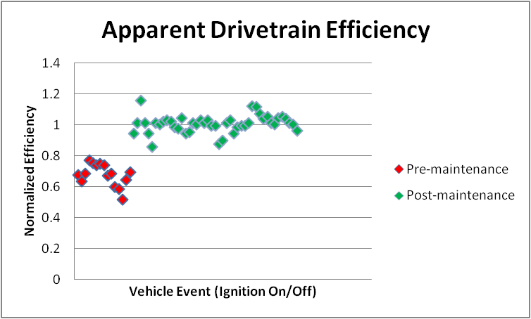
Predict Key Parameters
Predict key parameters (impractical to measure directly, but required for modelling) with low cost sensors and analytics, using engineering and physics
Engine Health Outlier Detection
Problem
Predict maintenance requirements for vehicles in a fleet prior to poor performance impacting operations
Approach
Use parameters like Engine Power Drop indicative of many root problems to identify outliers
Outcome
Became Diagnostic tool for: Low boost pressure, MAP sensor failure, fuel supply failure, abnormal usage / abuse
Identified vehicles requiring maintenance and optimized fleet availability
Parameters like drivetrain efficiency and engine power drop is indicative of many root problems
f ( pedal position, inertia, gradient, drag and rolling)
Used to identify outliers, units requiring maintenance within fleet

Slide 16
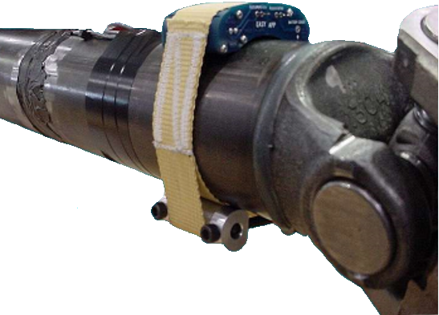
Predict Key Parameters (cont’d)
Predict key parameters (impractical to measure directly, but required for modelling) with low cost sensors and analytics, using engineering and physics
Problem
Predict damage to driveshaft without having to rely on sensor retrofit (easily damaged in field)
Approach
Utilized sensors on a few vehicles and correlated to calculated torque using low cost vehicle bus data
Outcome
Able to calculate torque placed on driveshaft without requiring additional instrumentation
Derived torque used to estimate damage and remaining life
Optimized maintenance schedules
Notional Data
Driveshaft Damage Prediction
Instrumented Driveshaft
Parameter / Channel | Source
Fore / Aft Acceleration | IMU
Output Shaft Speed | Vehicle Bus
Percent Engine Load | Vehicle Bus
Engine Percent Torque | Vehicle Bus
d(Output Shaft Speed)/dt | Vehicle Bus

Slide 17
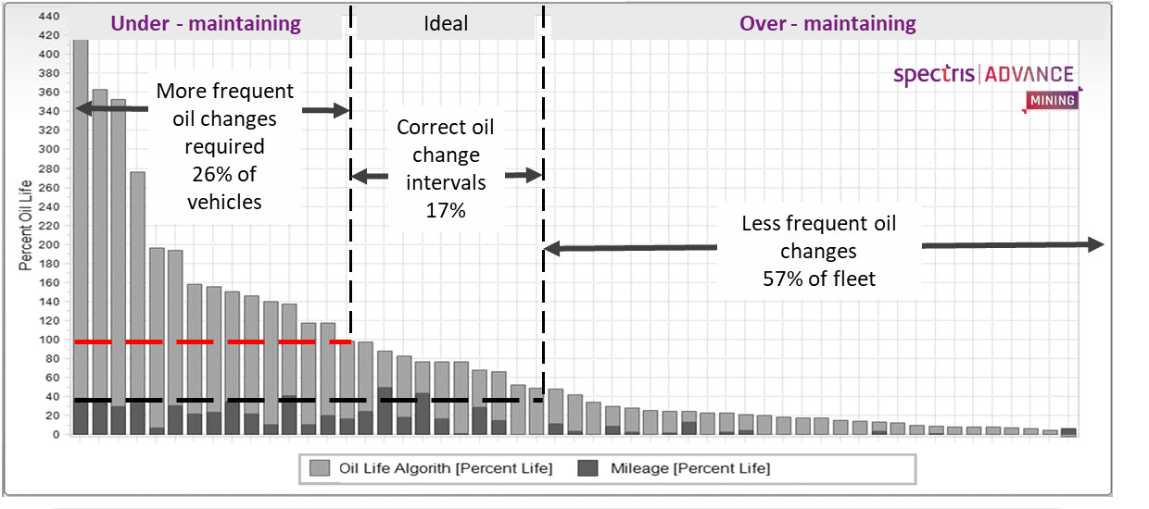
Maintenance Optimization
Engine Oil Deterioration
Model Accounted for
  Engine Oil Temperature
  Engine Speed
  Engine Load
  Engine Cranking
  Environmental
Model Output
  Equivalent Time (Engine) (Adjusted time metric to scale the system base operating time by factors (> 1) to account for time outside ideal operating efficiency ranges (e.g. oil temperature, engine speed, etc.)
Schedule / Mileage based
Oil Changes:
26% of fleet needed more oil changes
57% of fleet needed less oil changes
70% reduction in oil changes plus up to 40% increase in engine life

Slide 18
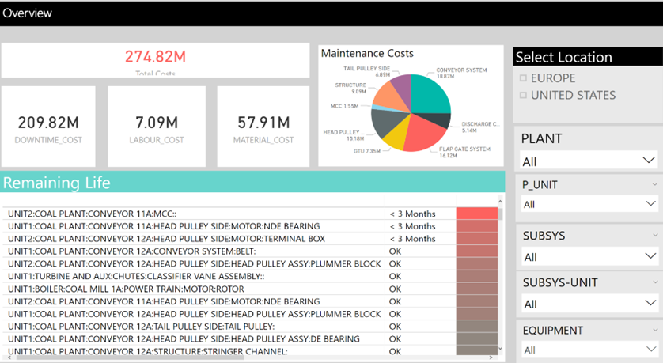
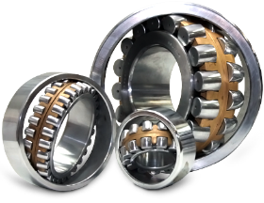
Condition Monitoring & Remaining Useful Life
Bearing Fault Detection
Digital signal processing
Acoustic and vibration analysis
Durability analysis
Fatigue life prediction
Damage / usage analysis

Slide 19
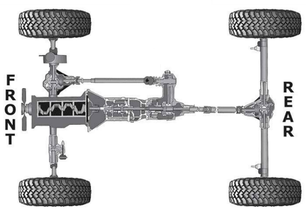
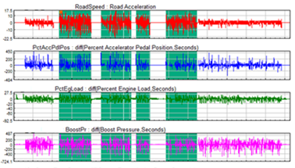

Combine Engineering with Machine Learning
AI + Engineering - Combine machine learning with physics to realize better accuracy in the predictions and recommendations
Vehicle Speed
Measured Here
Needed Here
Transmission
Transfer Case
Problem: understand damage to drivetrain and its cause with data constraints
Attempted correlating vehicle speed with usage with ML - poor correlation observed
Approach
Identify features: Neutral-Neutral cycles
Selected meaningful cycles
(Speed > 5mph, Duration > 15s)
Apply appropriate physics
Apply Machine Learning to vehicle bus parameters
Results
Correlated high/low range to vehicle bus
70% accuracy with engineering approach
80% accuracy with Machine Learning (ML)
95% accuracy with ML and physics
Identified poor driving behavior to help reduce drivetrain damage

Slide 20

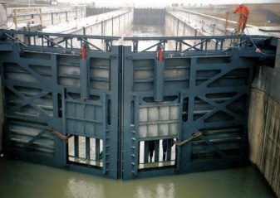
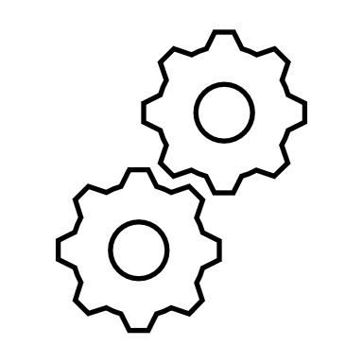
Example - Improve Accuracy by combining
PoF and ML
AI + Engineering – correlate sensor measurements to structural gaps using finite element modelling
Problem
Gate bending next to the quoin block (wall)
The bending creates gaps
Stresses can increase and gate can collapse
Traditional Approach
Input
Output
Model
ML Approach
Input
Model
Output

Slide 21
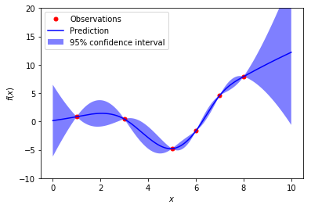
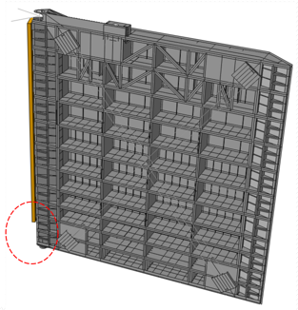
Example - Improve Accuracy by combining
PoF and ML (cont’d)
AI + Engineering – correlate sensor measurements to structural gaps using finite element modelling
Problem
Gate bending next to the quoin block (wall)
The bending creates gaps
Stresses can increase and gate can collapse
Results
Correlated strain measurements to gap length
96% accuracy with Neural Networks and Gaussian Process Regression
Approach
Use existing strain gauges that are located on the gate
Build a representative FE model of the gate
Run the FE simulation to generate data
Apply Machine Learning to correlate the strain measurements with the gap length
FE Model

Slide 22
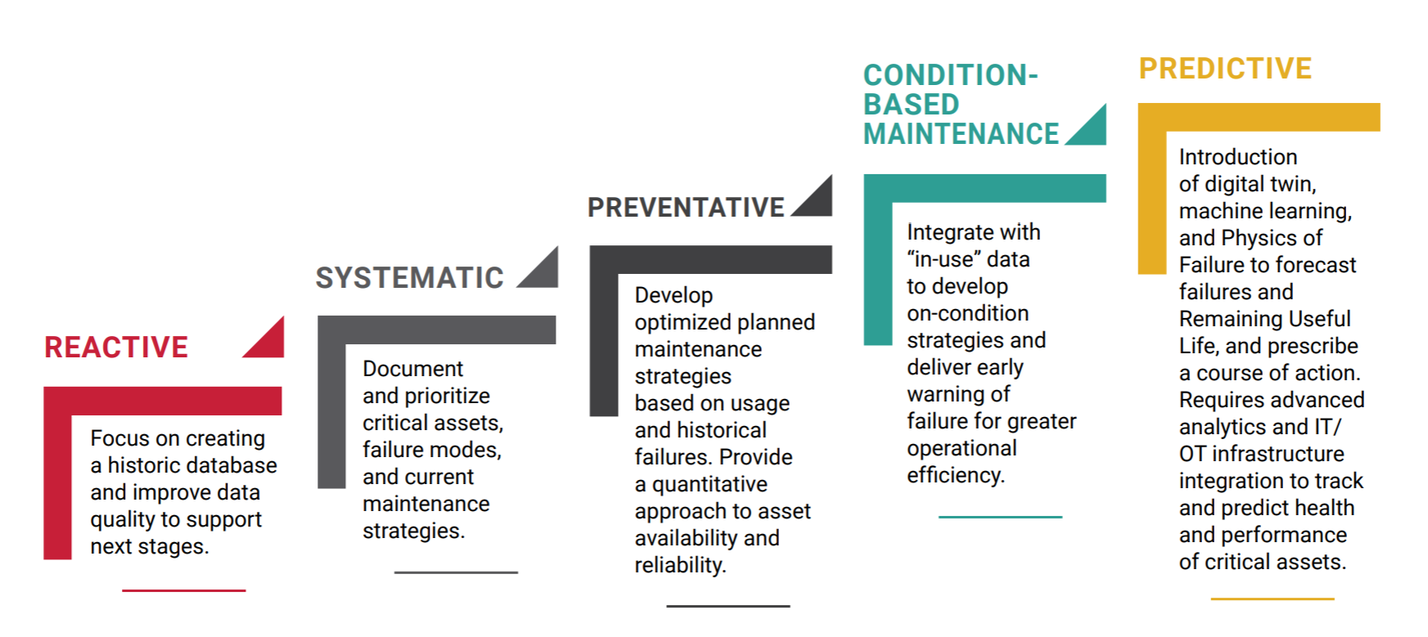
Summary

Slide 23
Thank you for your attention
Questions

