Slide 1
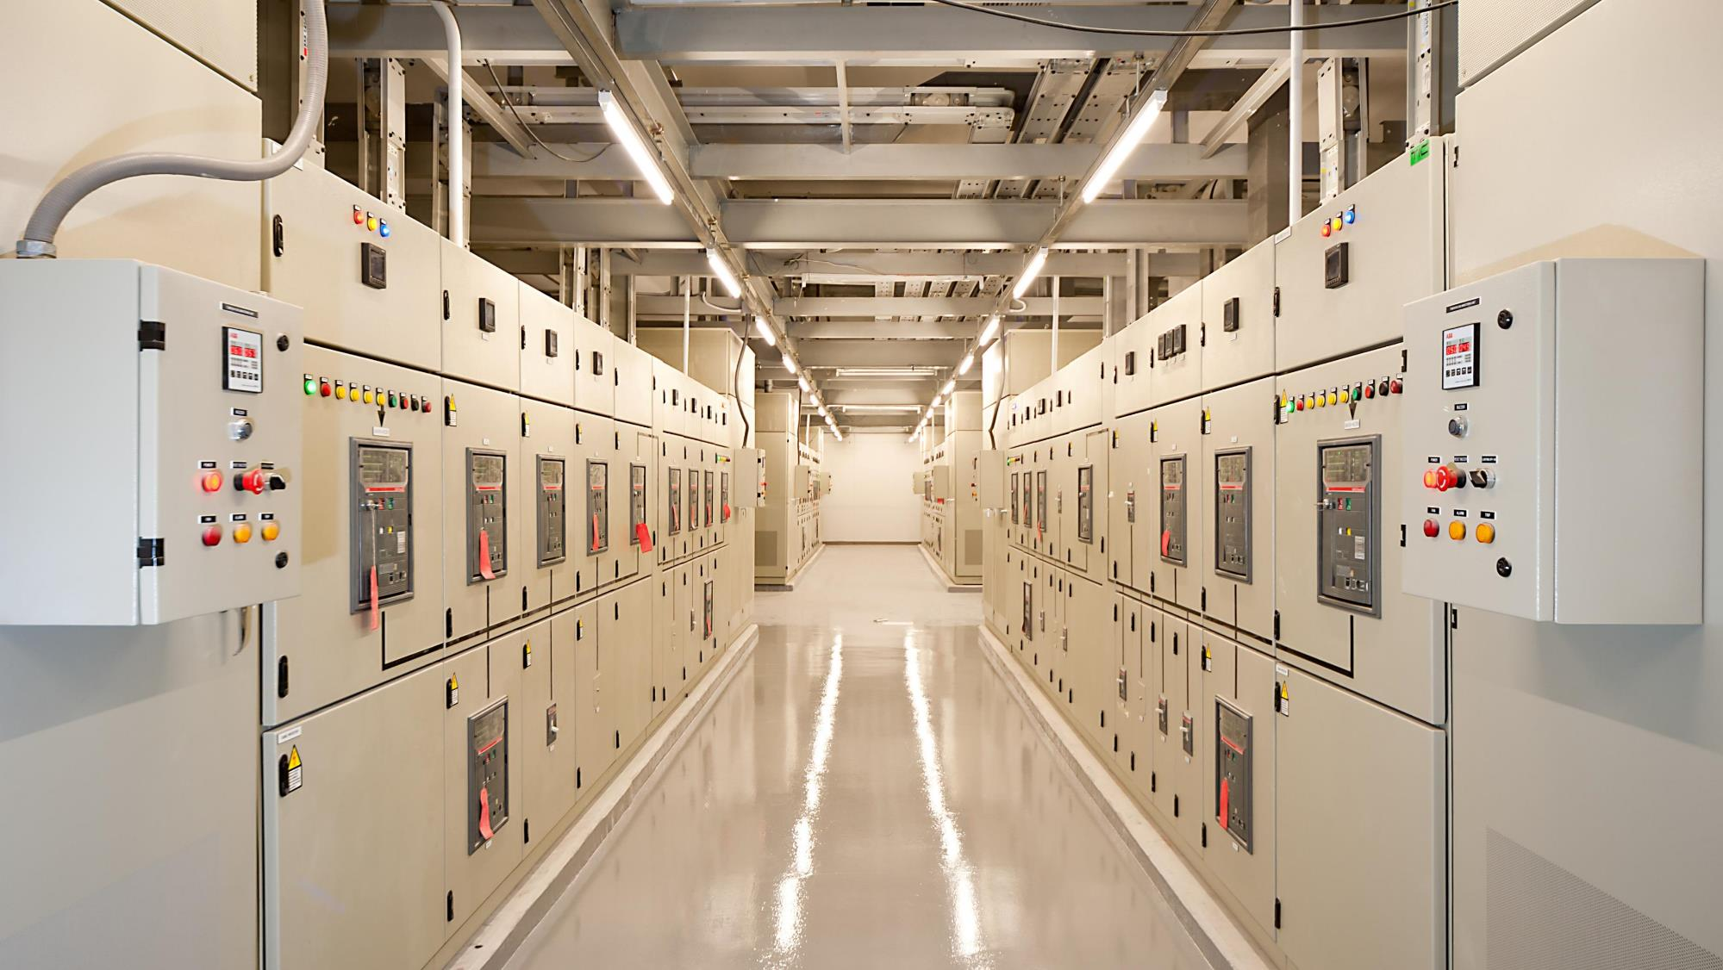

Condition Based Strategies for Electrical Asset Reliability
Martin Robinson, CEO IRISS Group.
Notes:
The Business Case
Ask Yourself The Following Questions?
What is your dependence on electrical energy and control systems?
What are the consequences of an unplanned mishap in your electrical systems?
How long will it take you to recover from an unplanned outage?
How are you going to improve your electrical distribution systems reliability?

Slide 2

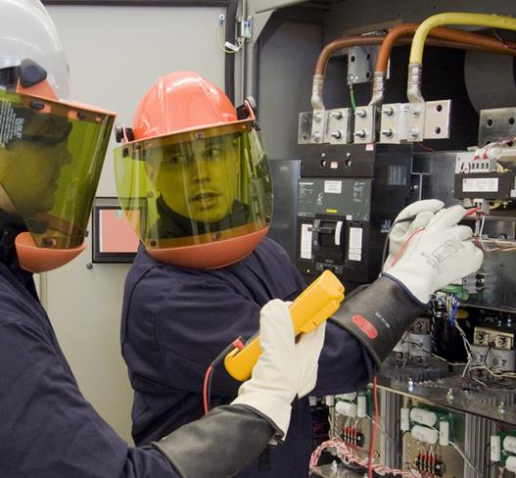
Traditional Electrical Maintenance practices
Traditional Maintenance and testing of electrical systems utilize intrusive, time diected work practices such as:
Tightness / Torque testing
Megger / Stress testing
Circuit Testing
Load Bank Testing
Breaker and Isolator Testing
Etc…
These “Maintenance Tasks” are designed with one outcome in mind: “To confirm whether of not the circuits and connections are safe and that the system meets its “Operational Requirements”.
IS THERE IS A BETTER WAY????

Slide 3
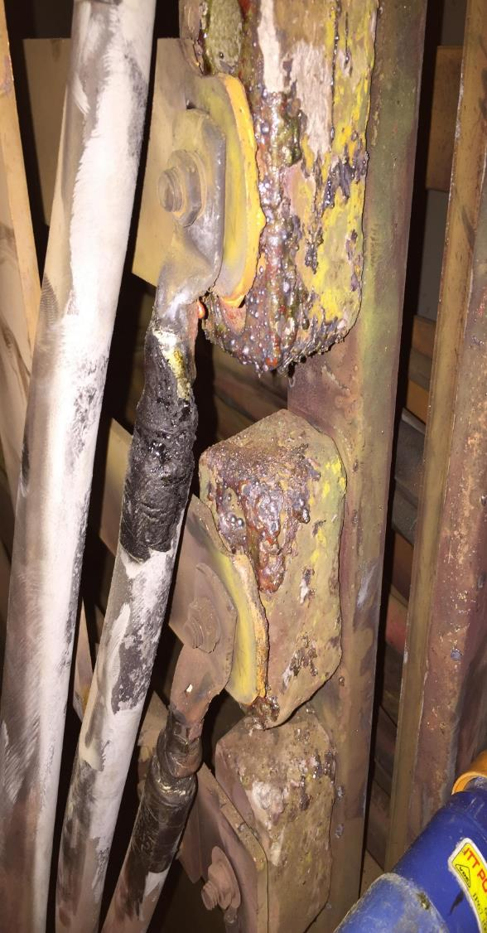
Reliability Centered Maintenance Studies
United Airlines 1960’s - 70’s data by Maintenance Steering Groups
  Commercial Jet Aircraft (707, 737 & DC-8 - pre-jumbo jet)
Broberg Study - April 1973
  Commercial Aircraft – Europe – pre jumbo jet
Maintenance System (Development) Program (MSP) Study - 1980’s data reported in 1993
  U.S. Navy Surface Warships
SUBMEPP Study – 1990’s data reported in 2001
  U.S. Navy Los Angeles Class Attack Submarines

Slide 4
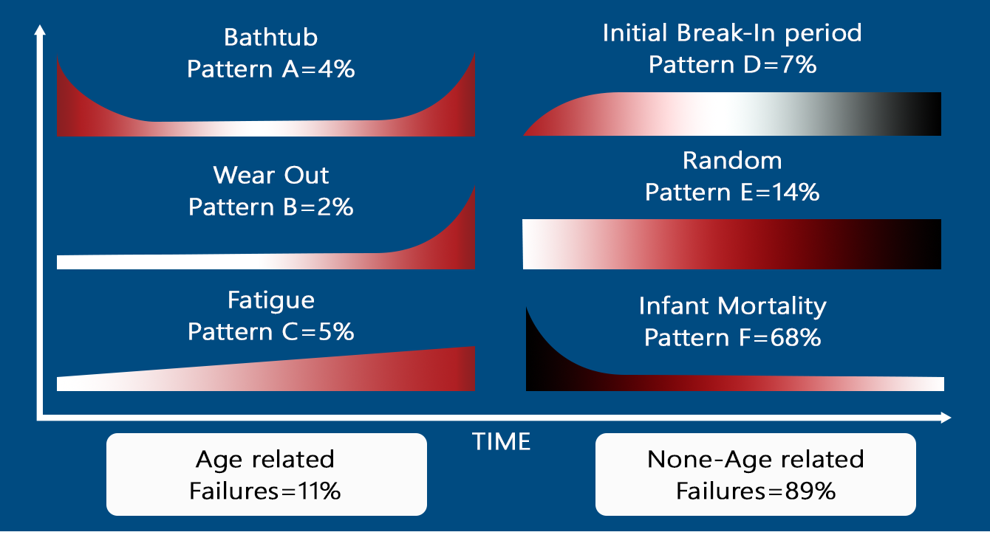
Equipment Failure Pattern Distribution from 3 Major Studies
3-4%
6-11%
1-17%
14-22%
3-5%
29-68%
77-92%
8-23%
77-92%
Notes:
The failure Characteristics shown were first noted in a report titled “Reliability Centered Maintenance by F. Stanley Nowlan and Howard. F Heap. Follow-on Studies in Sweden in 1973 and by the US Navy in 1983 produced Similar results….
In These Studies random failures accounted for 77 – 92 percent of the total failures and age related failure characteristics for the remaining 8 – 23 percent!
RCM curves are the Age-Reliability behavior curves which graph the Conditional Probability of failure against age.
The patterns of failure illustrate failure probability against time and can be split into two broad categories:
Age-related Failures (wearing out)
Random Failures (No wear out pattern).
It should be noted that the most common failure mode is type F, which starts out with a fairly high “infant mortality decreasing to a constant failure probability.

Slide 5
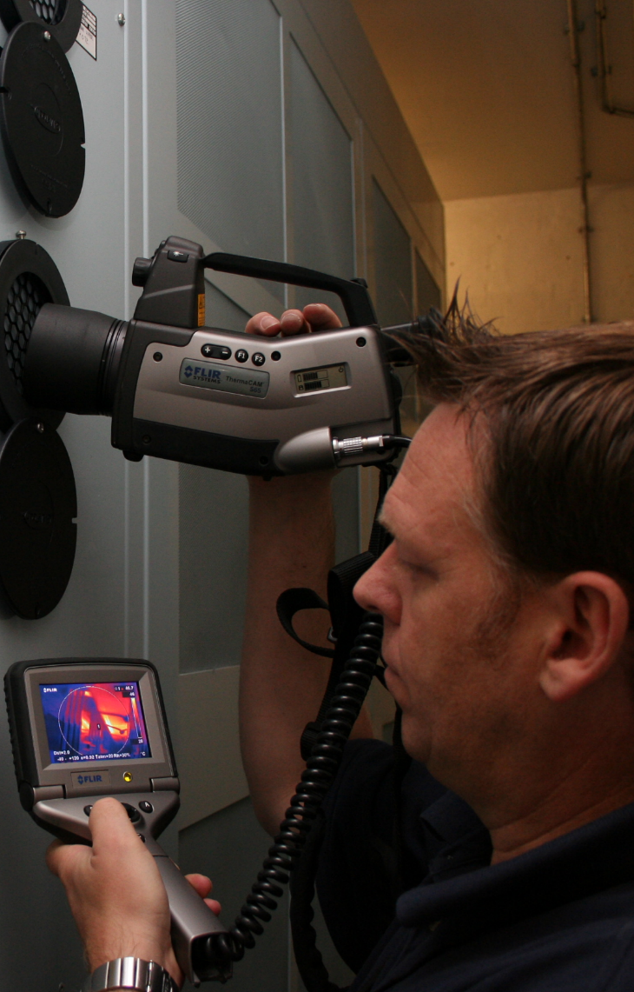
Infant Mortality and Planned Time-Directed Tasking
It Wasn’t Broke,
But We Fixed It Anyway!

Slide 6
Equipment Failure Pattern Distribution from 3 Major Studies
If you believe that that the majority of failures in your equipment are other than random (i.e., wear out) and base your program on wear out, you are making the wrong bet at least 70% and perhaps as much as 90% of the time
3-4%
6-11%
1-17%
14-22%
3-5%
29-68%
77-92%
8-23%
77-92%
Notes:
The failure Characteristics shown were first noted in a report titled “Reliability Centered Maintenance by F. Stanley Nowlan and Howard. F Heap. Follow-on Studies in Sweden in 1973 and by the US Navy in 1983 produced Similar results….
In These Studies random failures accounted for 77 – 92 percent of the total failures and age related failure characteristics for the remaining 8 – 23 percent!
RCM curves are the Age-Reliability behavior curves which graph the Conditional Probability of failure against age.
The patterns of failure illustrate failure probability against time and can be split into two broad categories:
Age-related Failures (wearing out)
Random Failures (No wear out pattern).
It should be noted that the most common failure mode is type F, which starts out with a fairly high “infant mortality decreasing to a constant failure probability.

Slide 7

Reducing Maintenance Induced Failures
Notes:
Human Error is inevitable and using EMSD’s allows us to design our systems and processes around this inevitability.

Slide 8
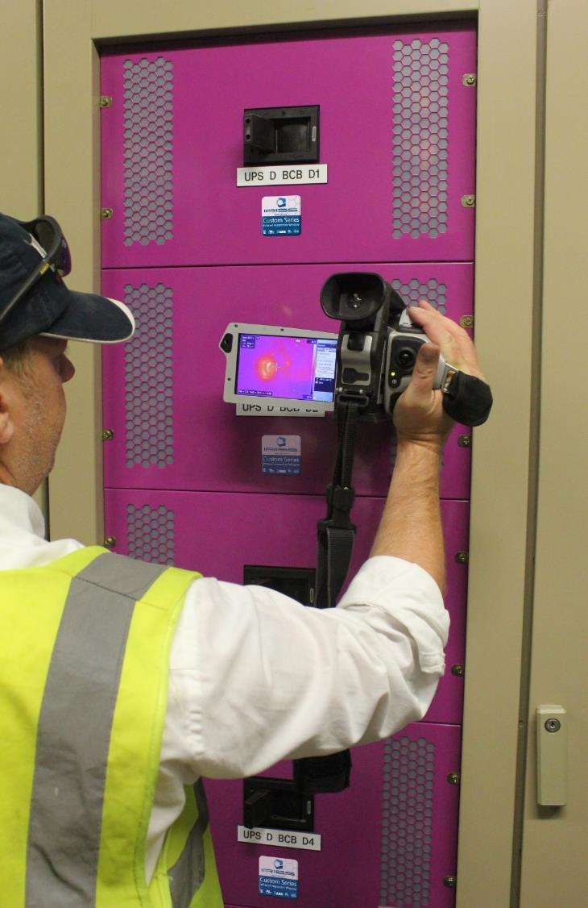
Condition-Directed Maintenance and Reliability
If It Ain’t Broke,
Don’t Fix It!
Notes:
Needed in recognition of the randomness of failure
Facilitated by the emergence of commercially available predictive maintenance tools and technologies in 1980’s and 1990’s

Slide 9

Notes:
“We can not solve our problems with the same level of thinking that created them”

Slide 10
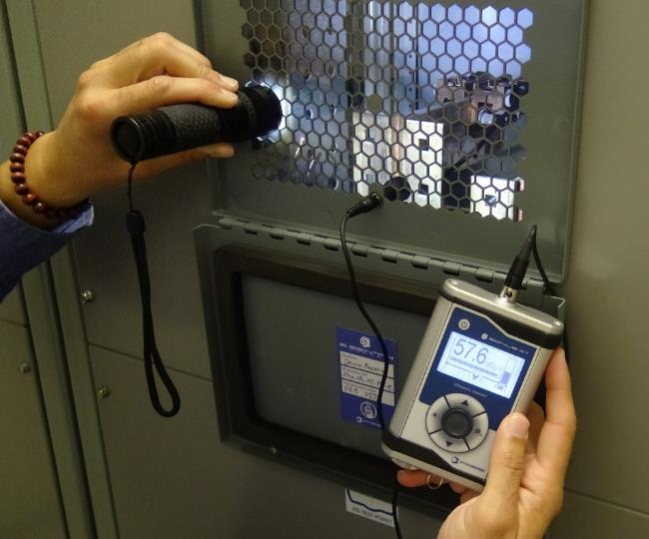
Critical Asset Surveillance Technologies (CAST)
The term CAST refers to a “Data Driven Risk Based 100% Surveillance Repair” maintenance model that utilizes condition based monitoring technologies to inspect electrical distribution assets. These surveillance and inspection methods determine the condition of the individual asset or system being inspected and include but are not limited to:
Infrared Thermography
Airborne Ultrasound
Motor Current Analysis
Partial Discharge Testing
Power Quality Analysis
Ultraviolet “Corona” Imaging
Vibration Analysis
Alignment Testing
Oil Analysis
Visual Inspections

Slide 11
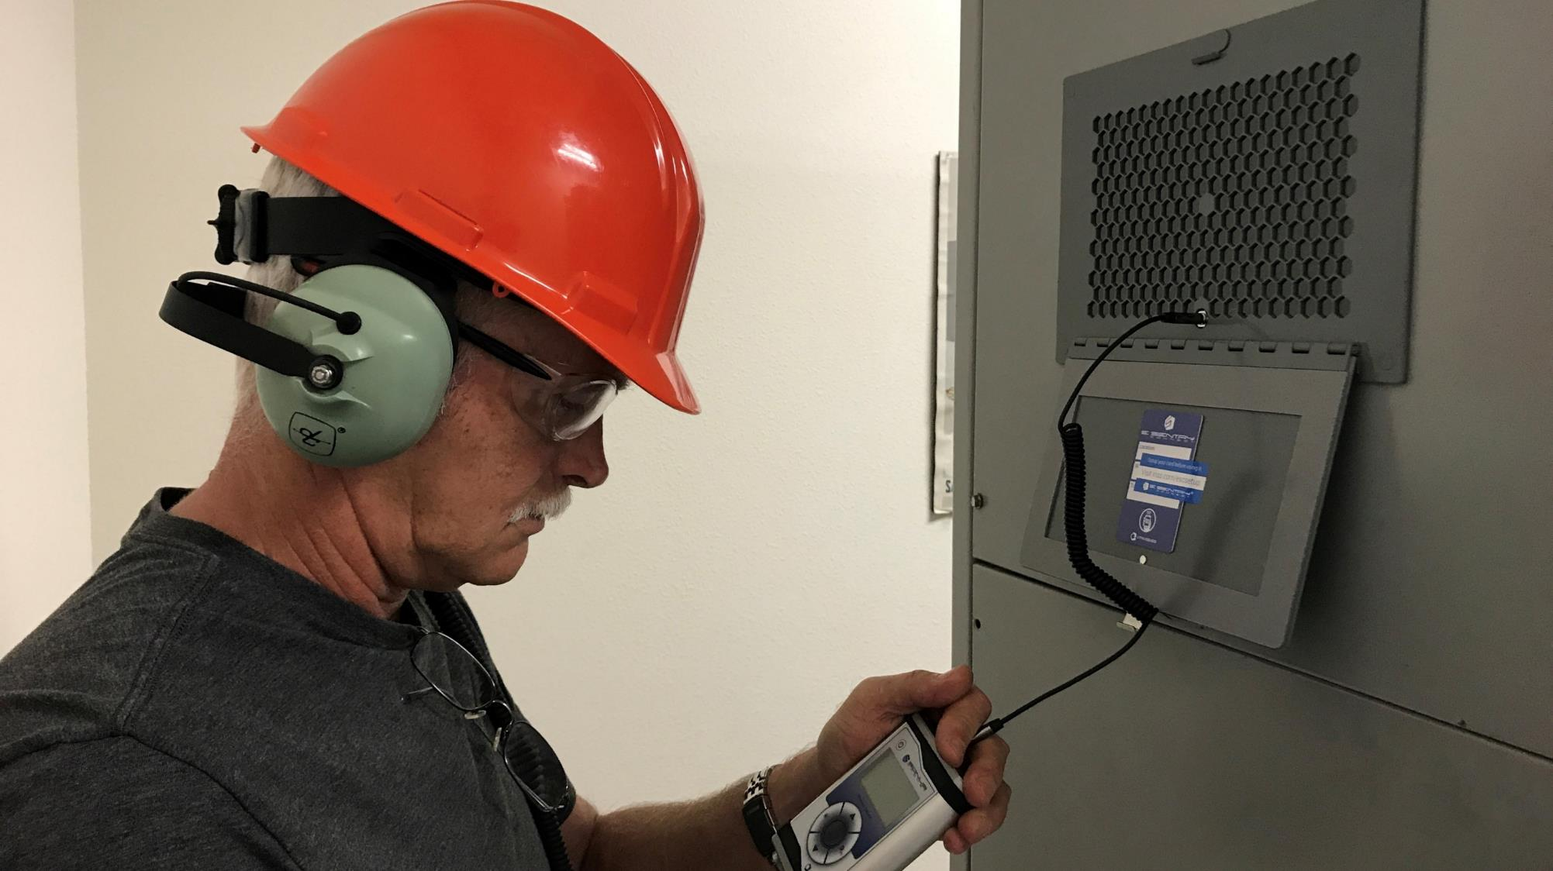
Critical Asset Surveillance Technologies (CAST)

Slide 12
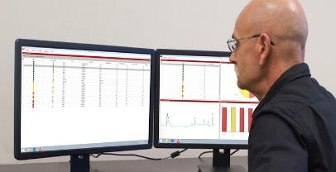
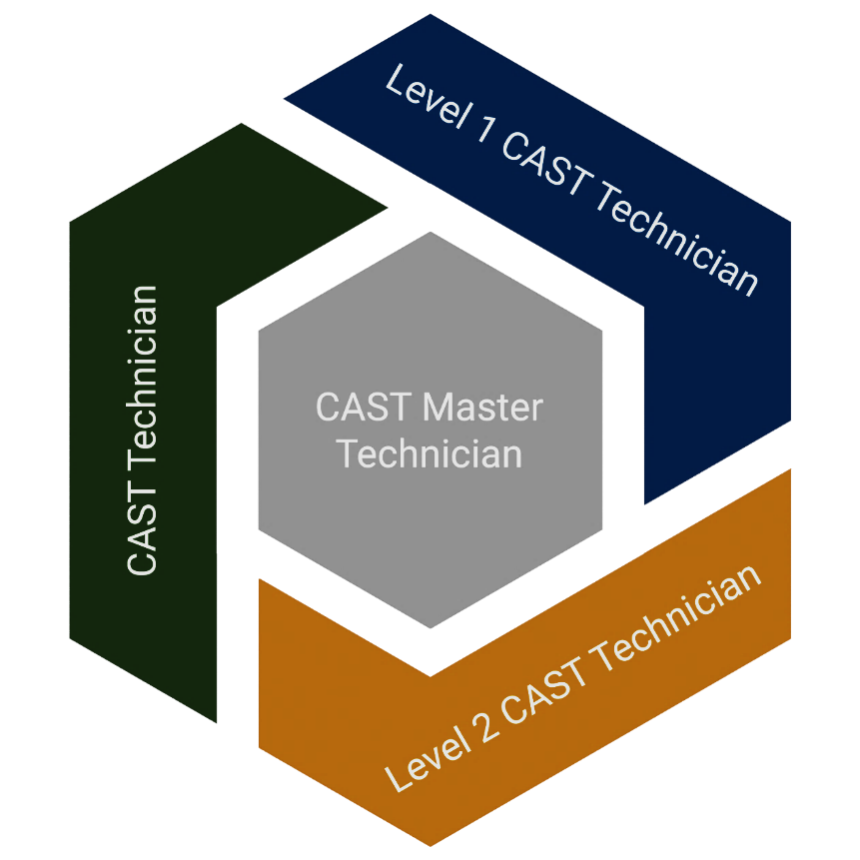
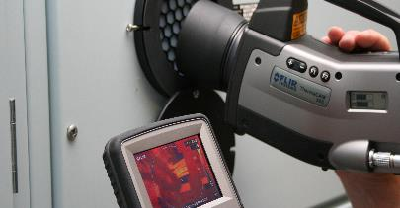

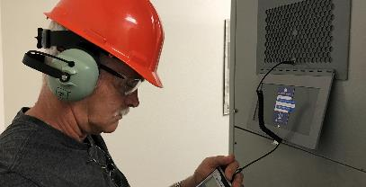
CAST Program Inspection Levels
CAST Master Technician
CAST Program Management
CAST Level 2 IR Technician
CAST Level 2 AE Technician
Duty Cycle Commissioning
CAST Level 1 IR Technician
CAST Level 1 AE Technician
Diagnose and Repair
CAST Technician
Routine Data Collection

Slide 13
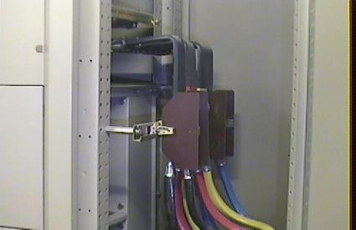
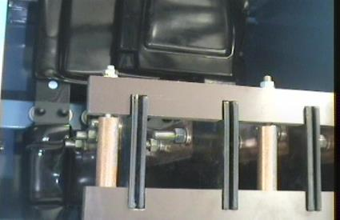
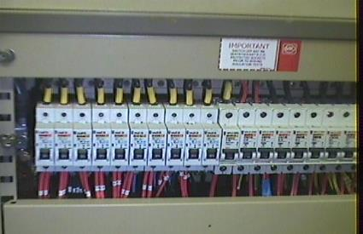
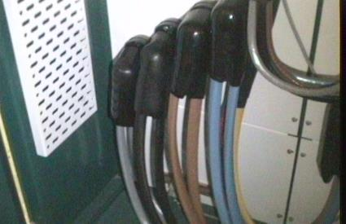
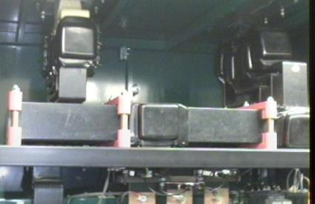
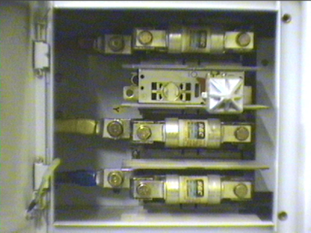
Where to Start?
First Identify The Components You Wish To Inspect
Cable Connections
Bus Bar Connections
Isolator or Circuit Breaker Connections
Then Identify The CAST Technologies you will use….
Notes:
Traditional Electrical Inspections commonly only look at the bolted connections within the switchgear as these are generally considered to be the “weakest points” or “points most likely to fail” these may include:

Slide 14
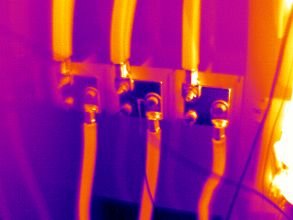
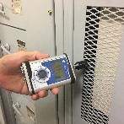
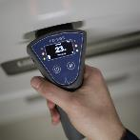
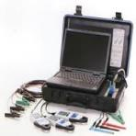
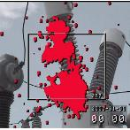
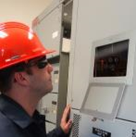
Electrical Connections must be inspected under load conditions to allow their condition to be validated
The Majority of Condition Based Test Equipment Require Energized systems
Infrared Scan
Ultrasound Scan
Partial Discharge
Motor Current Analysis
Ultraviolet Scan
Visual Inspection
Measures temperature caused by high resistance connections, load imbalance, etc…
Records Airborne Emissions at 40 kHz to identify Arcing Tracking and Corona.
Identifies cable insulation issues in energized systems of 5kV and above
Identifies faulty electrical circuits & components. Can be completed De-energized
Finds Corona issues in energized systems of 5kV and above
Visual identification of system integrity. Can be completed De-energized
**NFPA 70B Recommends a Minimum of 40% Load**
Notes:
Let’s look at a typical electrical connection and the possible modes of failure and how each technology can be utilized…

Slide 15


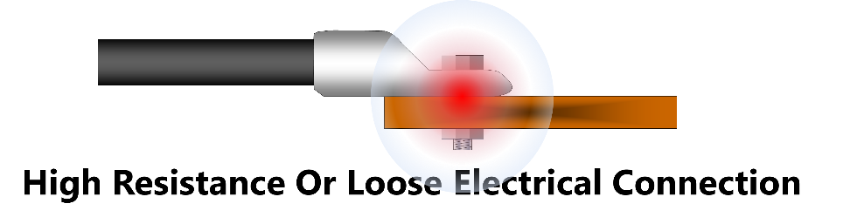

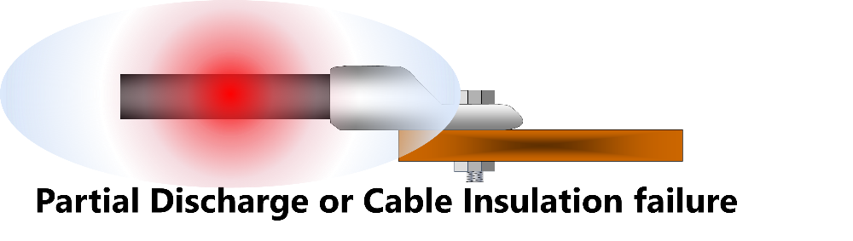

Electrical System Failure Modes

Slide 16

P-F Curve
Notes:
In the world of Maintenance and Reliability one may read information which sometimes becomes a little confusing. We wanted to provide a simple understanding of the P-F Curve and how it works in a proactive maintenance process.

Slide 17
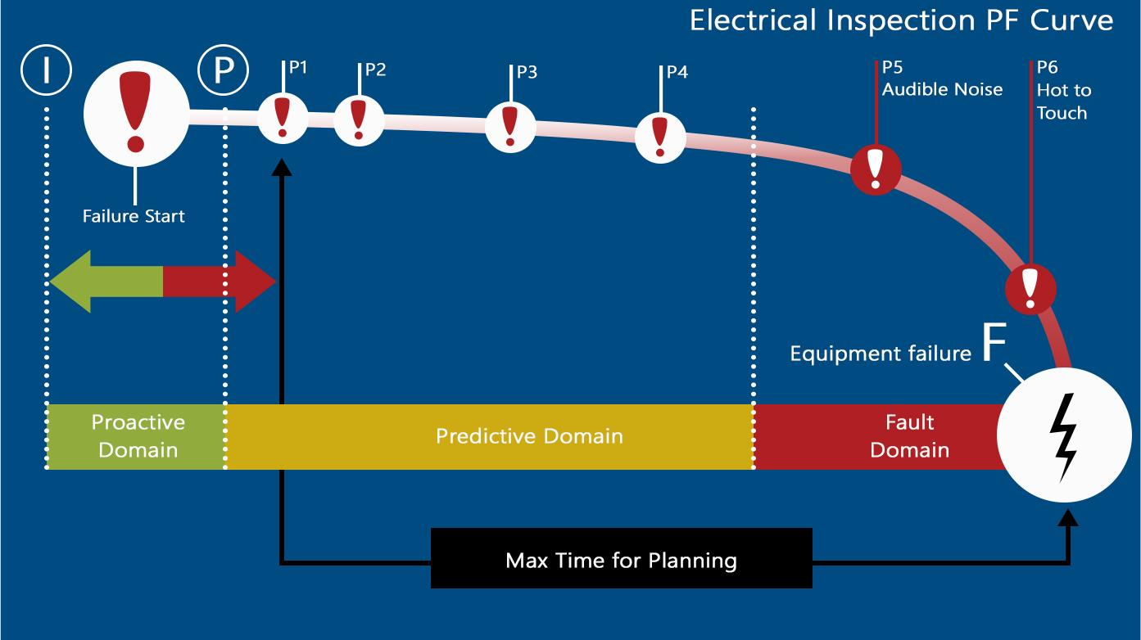

Slide 18
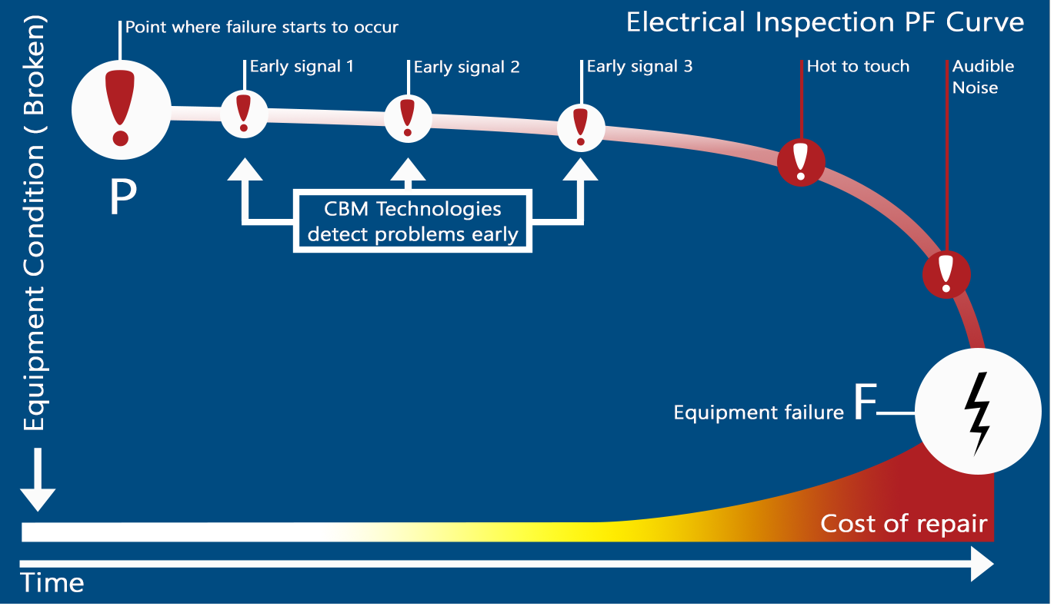
CAST Technologies detect problems early
Notes:
The patterns of failure illustrate failure probability against time and can be split into two broad categories, age-related and random. It should be noted that the most common failure mode is type F, which starts out with a fairly high “infant mortality decreasing to a constant failure probability.

Slide 19
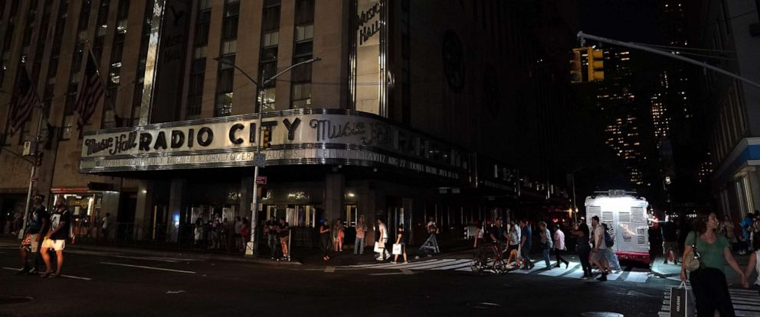

Identifying Hidden Failures
Notes:
A “hidden Failure” is a failure mode that will not become evident to the operator under normal working circumstances. i,.e. Breakers, switches, etc… Due to the nature of these “Life Safety Devices” the testing is done regularly on a time-based schedule.
Testing strategies for such devices are detailed in documents such as NFPA 70B where they recommend annual breaker cycling for lubrication and trip testing at least every 3 years to make sure The breaker opens within the required time (very Important as all PPE rating calculations depend of this operating as designed.

Slide 20
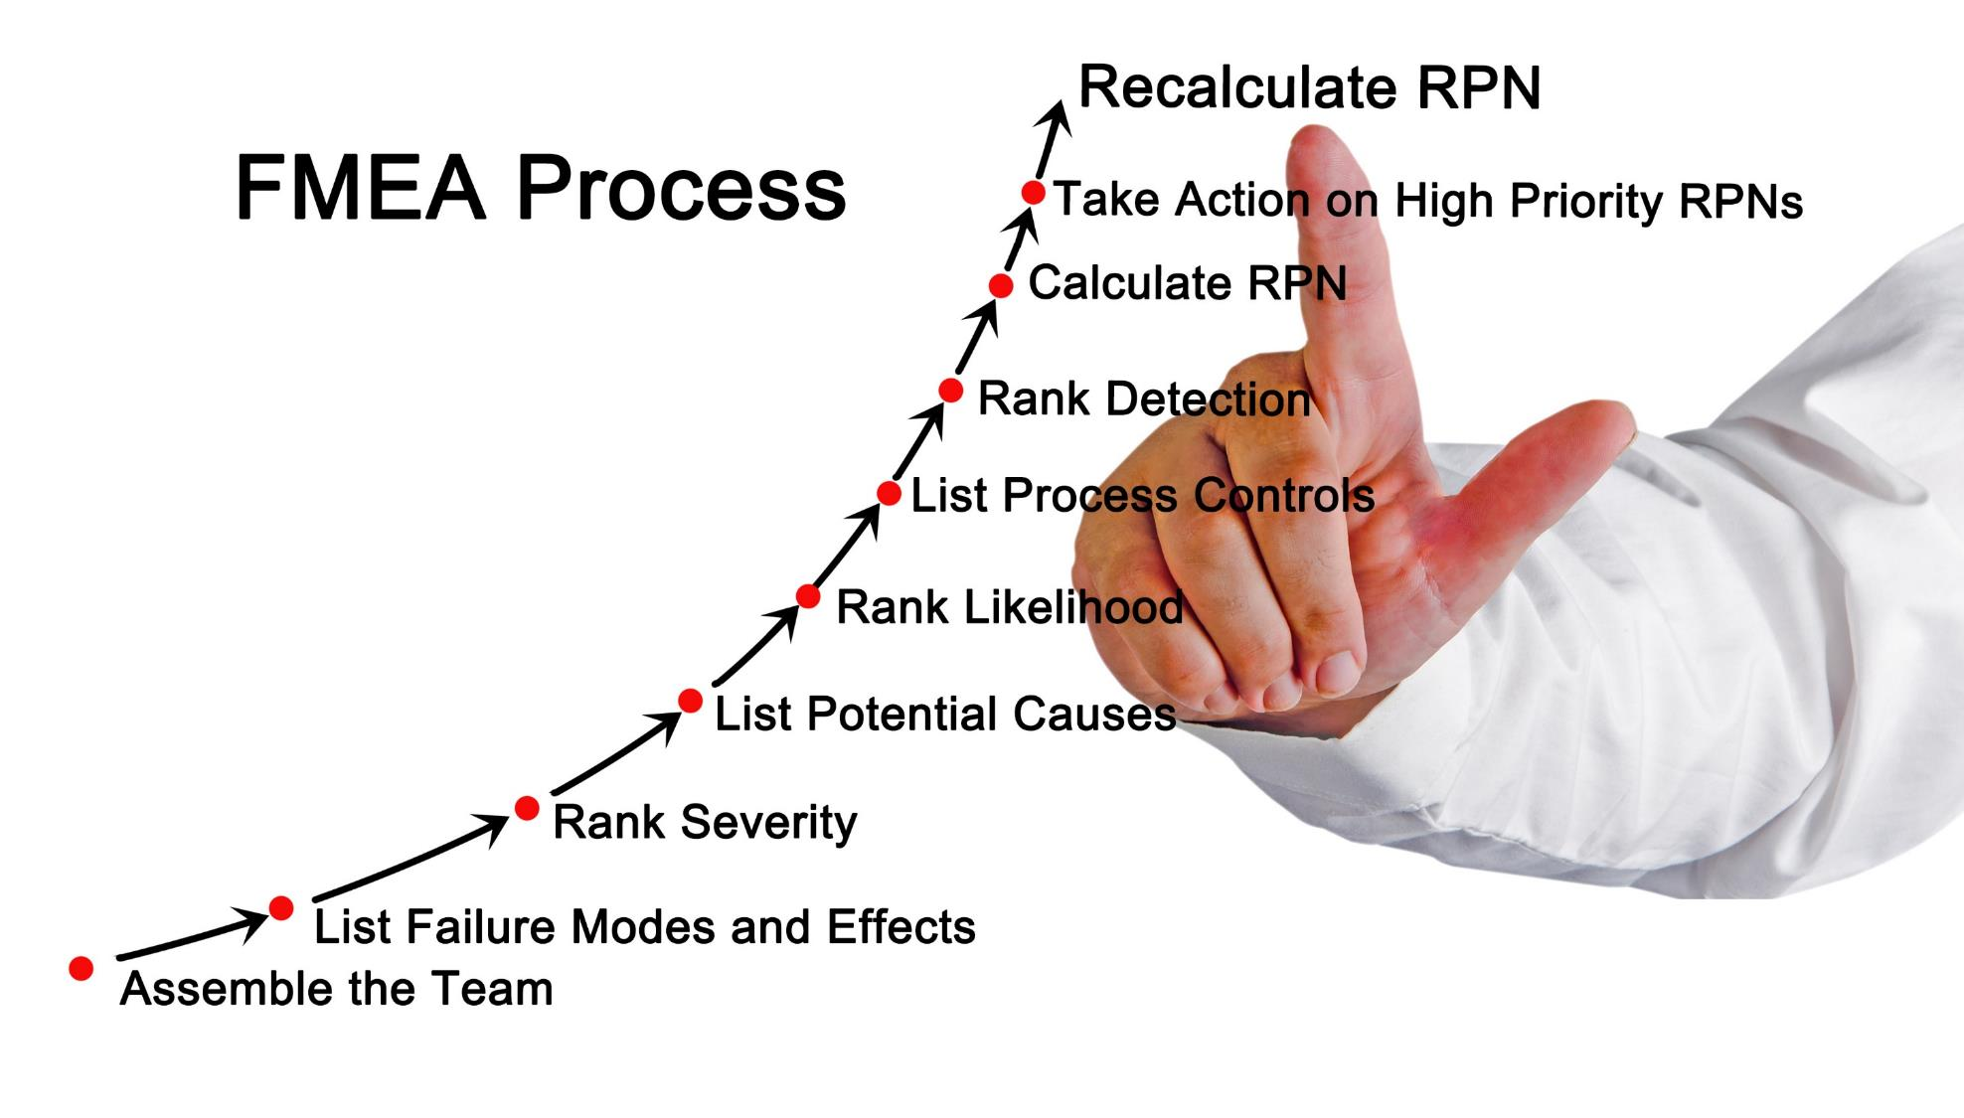

Slide 21
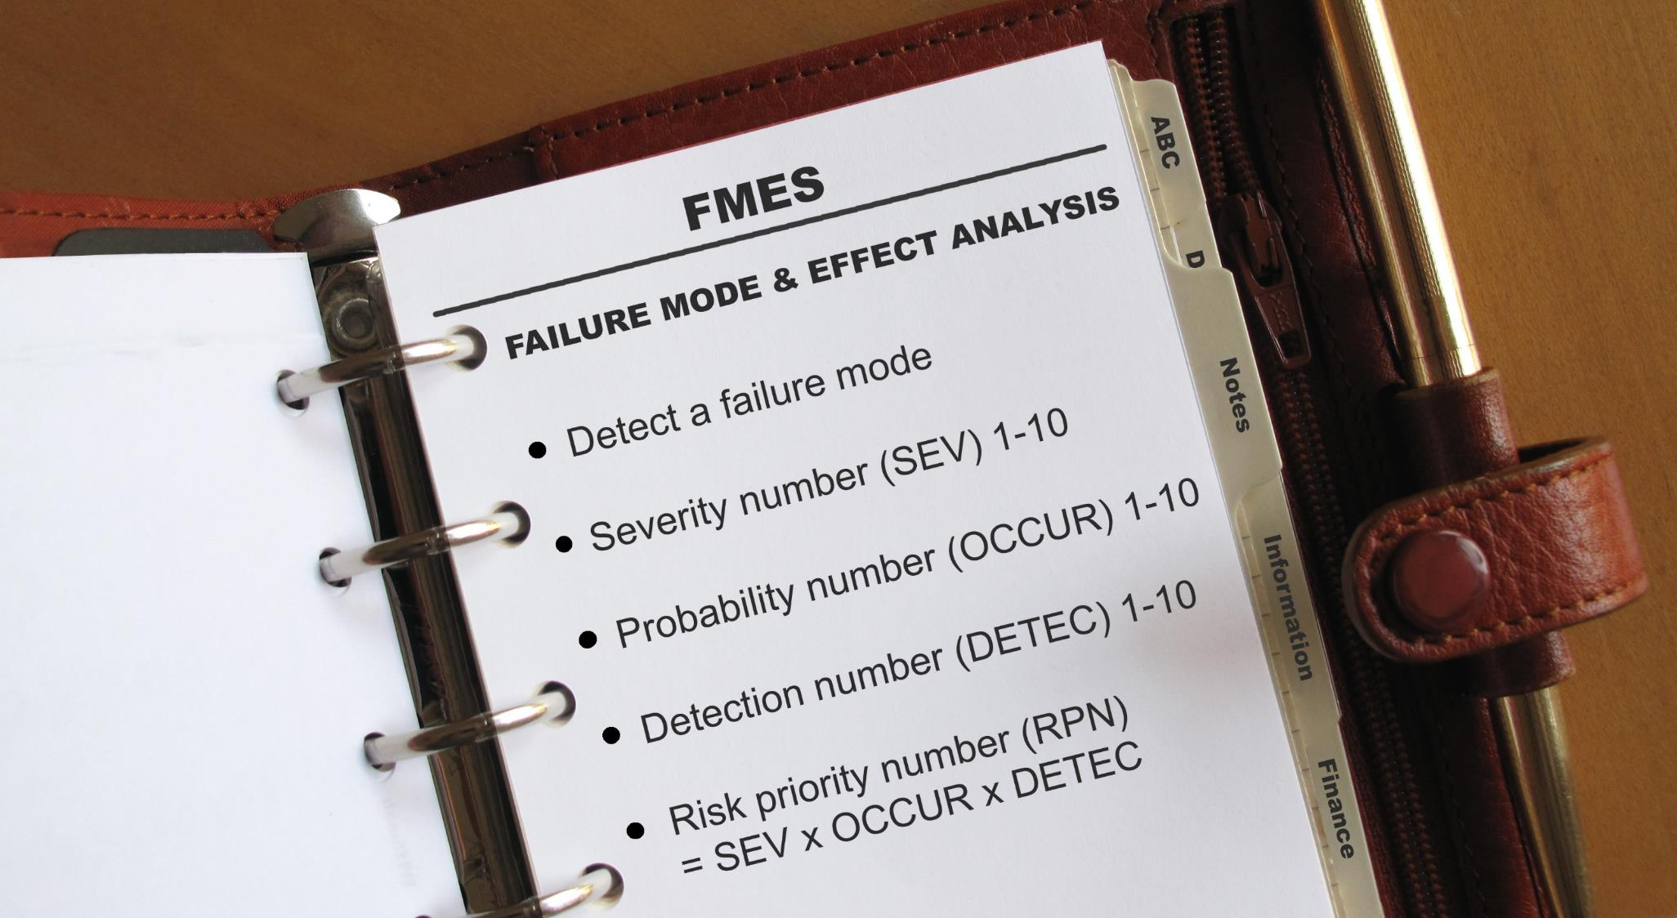
Notes:
Failure Modes and Effects Simulation / System (FMES) is used in reliability analysis for producing automatically generated failure mode and effects analysis (FMEA).
The Risk Priority Number, or RPN, is a numeric assessment of risk assigned to a process, or steps in a process, as part of Failure Modes and Effects Analysis (FMEA), in which a team assigns each failure mode numeric values that quantify likelihood of occurrence, likelihood of detection, and severity of impact.
Assign 1-10 for the capability of DETECTION of the failure mode. 1 being detectable every time, 10 being impossible to detect. Multiply the values for SEVERITY, OCCURRENCE, and DETECTION and the becomes the RPN, risk priority number.

Slide 22
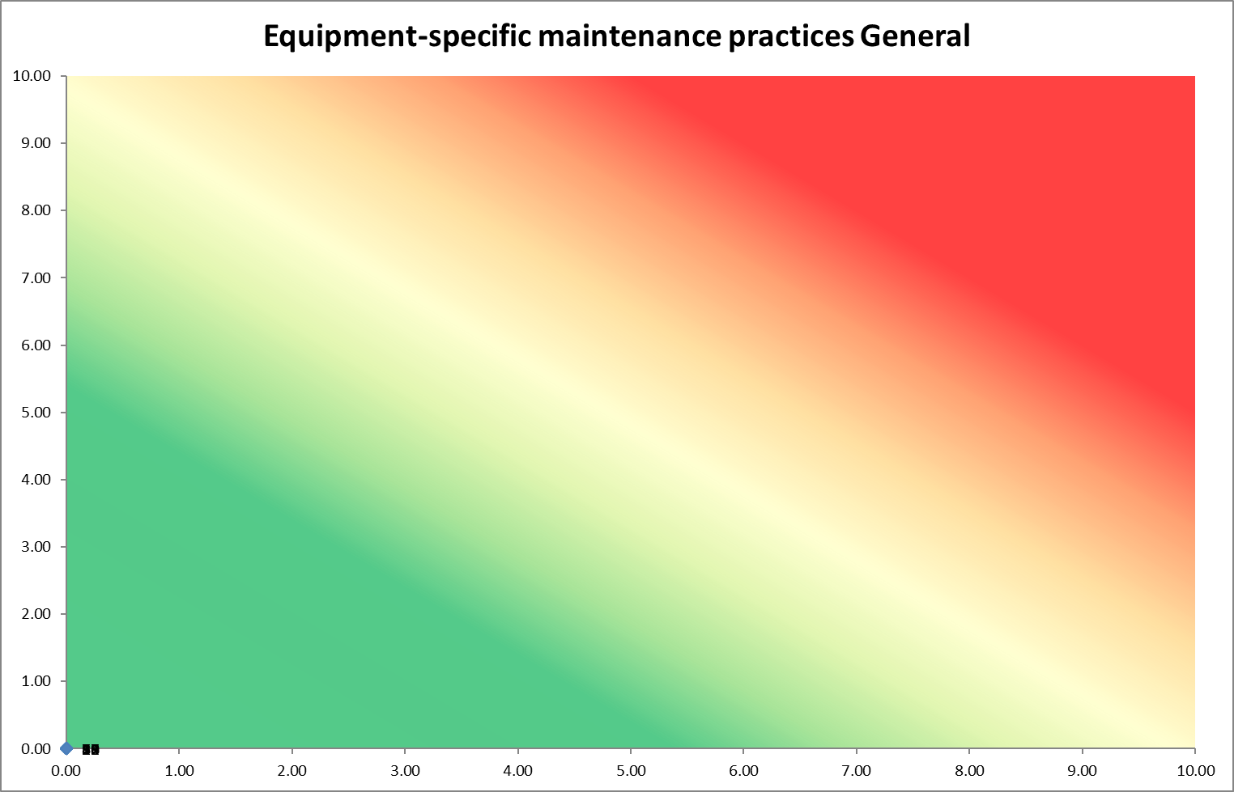
Risk Priority Number
Severity
Likelihood
Notes:
Risk Priority Number… RPN is calculated using a number of different methods, most simple method is to use the likelihood of failure multiplied by the severity of failure…
This number can then be used to assess the required maintenance systems to ensure that the RPN is managed within acceptable parameters
The above graphic shows an example of a RPN Heat map or simple risk matrix.

Slide 23


Notes:
Risk appetite and tolerance
According to the Institute of Risk management Risk appetite can be defined as ‘the amount and type of risk that an organization is willing to take in order to meet their strategic objectives. Organizations will have different risk appetites depending on their sector, culture and objectives. A range of appetites exist for different risks and these may change over time.
While risk appetite will always mean different things to different people, a properly communicated, appropriate risk appetite statement can actively help organizations achieve goals and support sustainability.
Risk appetite and performance
While risk appetite is about the pursuit of risk, risk tolerance is about what an organization can actually cope with. Organizations have to take some risks and avoid others. To do so, they need to be clear about what successful performance looks like. This question may be easier to answer for a commercial organization than for a government department, but can usefully be asked by boards in all sectors.
Note: The higher an organizations Risk appetite the lower the asset management costs, adversely the lower the appetite the higher the costs!!

Slide 24
Risk Appetite Maintenance Plan Selections
Online Monitoring
Monthly Inspection
Quarterly Inspection
Severity
Semi-Annual Inspection
Annual Inspection
Likelihood
Notes:
The above graphic shows an RPN heatmap with an overlaid “Risk appetite

Slide 25

Notes:
Failure Modes and Effects Simulation / System (FMES) is used in reliability analysis for producing automatically generated failure mode and effects analysis (FMEA).
The Risk Priority Number, or RPN, is a numeric assessment of risk assigned to a process, or steps in a process, as part of Failure Modes and Effects Analysis (FMEA), in which a team assigns each failure mode numeric values that quantify likelihood of occurrence, likelihood of detection, and severity of impact.
Assign 1-10 for the capability of DETECTION of the failure mode. 1 being detectable every time, 10 being impossible to detect. Multiply the values for SEVERITY, OCCURRENCE, and DETECTION and the becomes the RPN, risk priority number.

Slide 26

Notes:
When seeking to protect your personnel and assets remember the following:
Human Error Is Both Universal And Inevitable
Human Error is not a moral issue; making errors is as much part of human life as eating and breathing.
Errors Are Not Intrinsically Bad
Success and failure spring from the same roots; we are error-guided creatures; errors mark the boundaries of the path to successful action.
You Cannot Change The Human Condition, But You Can Change The Conditions In Which Humans Work.
There Are 2 Parts To An Error:
Mental State
Situation
We Have Limited Control Over Peoples Mental States, But We Can Control The Situations In Which People Work.
The Best People Can Make The Worst Mistakes
No One Is Immune To Error. If Only The Inexperienced Were Responsible For Most Of The Errors, Then The Solution Would Be Simple, But Some Of The Worst Mistakes Are Made By The Most Experienced People.
People Cannot Easily Avoid Those Actions That They Did Not Intend To Commit
Blame And Punishment Are Not Appropriate When Peoples Intentions Were Good, But Their Actions Did Not Go As Planned. This Does Not Mean However, That People Should Not Be Held Accountable For Their Actions And Be Given The Opportunity To Learn From Their Mistakes.
Errors Are Consequences Rather Than Causes
Errors Are The Product Of A Chain Of Actions And Conditions Which Involve People, Teams, Tasks, Workplace And Organizational Factors. Discovering A Human Error Is The Beginning Of The Search For Causes, Not The End.
Many Errors Fall Into Recurrent Patterns
More Than Half Of Maintenance Errors Are Recognized As Happening Before – Often Many Times… Targeting These Recurring Errors Is The Most Effective Way Of Addressing Human Error Issues
Safety-significant Errors Can Occur At All Levels In The System.
Indeed, The Higher In An Organization That An Error Is Made, The More Significant The Consequences.
Error Management Is All About Managing The Manageable.
Situations Are Not Manageable; Human Nature, In Its Broadest Sense Is Not…
Effective Maintenance Quality Management Aims At Continuous Reform Rather Than Local Fixes and is About Making Good People Excellent.
The Temptation Is To Resolve Errors One At A Time, As They Arise, But As Errors Seem To Be More Systemic In Nature. A More Appropriate Method Is To Deal With Human Error Systematically And Continuously. Maintenance Quality management is not about making a few error prone people better; it is a way of making the larger proportion of well trained people and motivated people excellent.

Slide 27
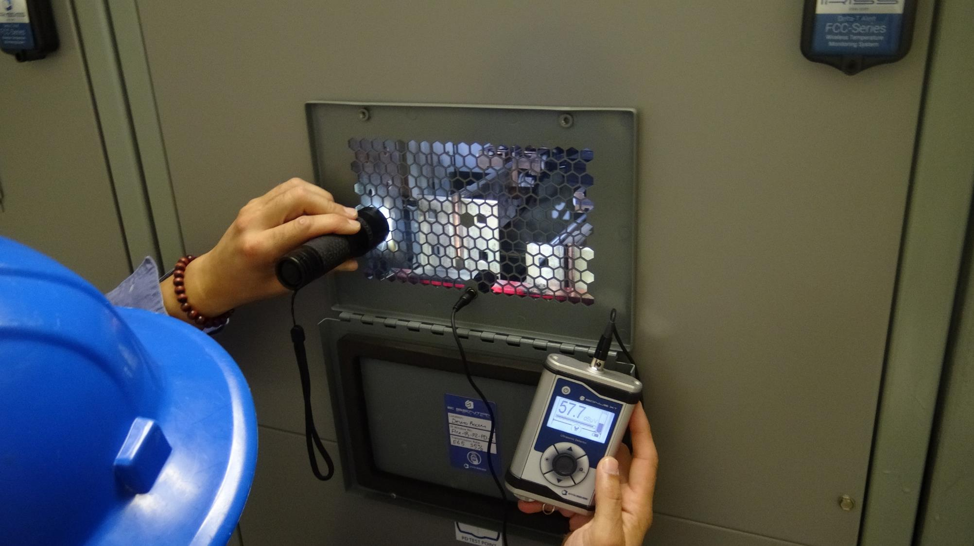
Electrical Maintenance Safety Devices
Notes:
The use of EMSD’s to facilitate CAST reduces the requirement of “hands on” calendar based maintenance and by reducing these hands on tasks we also reduce the number of “Maintenance Induced Failures” that affect your organization.
EMSD’s become data collection points for CAST equipment where we simplify the inspection process and identify all required parameters prior to the inspection. EMSDs allow us to collect the data safely but while equipment is energized and under normal load conditions – when the inspection is most likely to detect a problem.
The safety aspect should not be minimized. BLS data shows that 300-350 people are killed each year in the USA by electrocution with an arc flash component. Nearly 8000 more are injured and more than 45% of these suffer some form of permanent disability. Arc flash injuries include severe burns, hearing loss,
KISS: “Keep it Simple, Stupid” Inspection programs utilizing CAST and EMSD’s also ensure that the task of data collection and equipment monitoring are simple and repeatable and SAFE.
KISS is not meant to imply stupidity, on the contrary, it is usually associated with intelligent systems that may be misconstrued as stupid because of their simplistic design.
Poka-yoke (ポカヨケ?) [poka yoke] is a Japanese term that means "mistake-proofing". A poka-yoke is any mechanism in a lean manufacturing process that helps an equipment operator avoid (yokeru) mistakes (poka).
Albert Einstein:
"Everything should be made as simple as possible, but not simpler." This means that one should simplify the design of a product and success is achieved when a design is at its maximum simplicity.

Slide 28
Importance of Electrical Safety
1 to 300
1 to 10
1
Fatality
1
Fatality
30 Lost-time
Injuries
300 Recordable Injuries
10 Recordable Injuries
30,000 Near Misses
Electrical Safety
300,000 At-Risk Behaviors
So it could take just 10,000 electrical at-risk behaviors to lead to a fatality?
Overall Safety

Slide 29
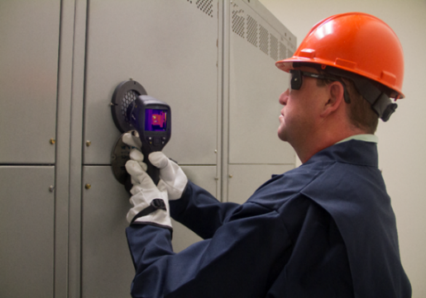
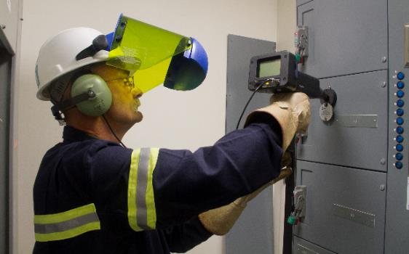

Electrical Maintenance Safety Devices
Inspection Windows
Ports
Online Monitoring
Round / Rectangular Inspection Windows
Visual / IR / UV spectrums
Custom designed Inspection Windows
Ultrasound
External Voltage Indicators
MCA Tap Off’s
Power Quality
Data ports
Temperature Monitoring
Asset Tags & Monitoring
Vibration Analysis
Partial Discharge
Power Quality

Slide 30


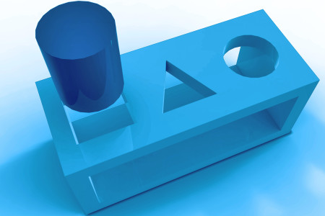
Mistake Proofing Reliability
Design and Implementation of Actions to prevent Defects in Our Everyday activities and processes
Errors should not be considered inevitable. Any type of error can be reduced considerably, if not eliminated altogether
Creates Safer Work Environment
Assures Consistency of Quality Results
Makes Problems More Visible
Lowers Cost of Design (DFM) and Cost to Manufacture

Slide 31
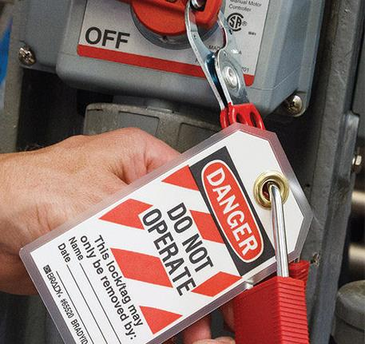
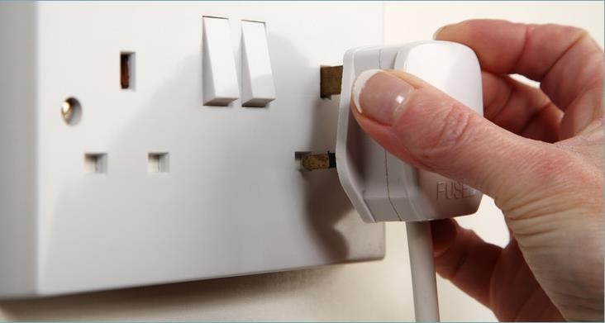
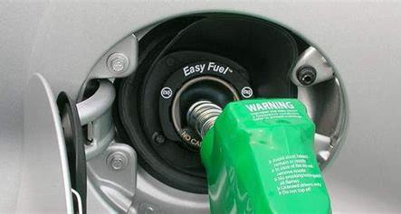
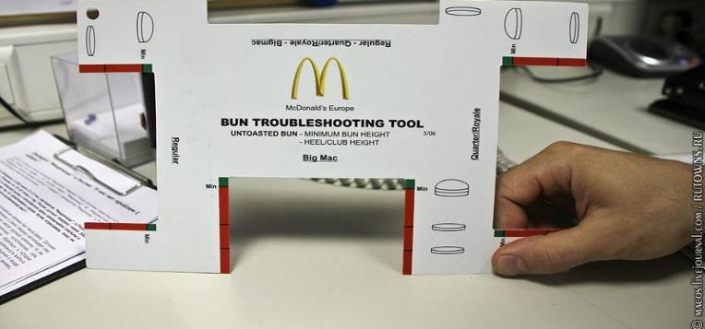

Slide 32

Notes:
Failure Modes and Effects Simulation / System (FMES) is used in reliability analysis for producing automatically generated failure mode and effects analysis (FMEA).
The Risk Priority Number, or RPN, is a numeric assessment of risk assigned to a process, or steps in a process, as part of Failure Modes and Effects Analysis (FMEA), in which a team assigns each failure mode numeric values that quantify likelihood of occurrence, likelihood of detection, and severity of impact.
Assign 1-10 for the capability of DETECTION of the failure mode. 1 being detectable every time, 10 being impossible to detect. Multiply the values for SEVERITY, OCCURRENCE, and DETECTION and the becomes the RPN, risk priority number.

Slide 33
Risk Priority Number After EMSD Program Implementation
Severity
Likelihood
Notes:
Risk Priority Number… RPN is calculated using a number of different methods, most simple method is to use the likelihood of failure multiplied by the severity of failure…
This number can then be used to assess the required maintenance systems to ensure that the RPN is managed within acceptable parameters
The above graphic shows an example of a RPN Heat map or simple risk matrix.

Slide 34

Bridging the Skills Gap
Notes:
For the last three years, the hardest segment of the workforce for employers to staff with skilled talent hasn’t been registered nurses or engineers or even web developers. It’s been the skilled trades – the welders, electricians, machinists, etc. that are so prevalent in manufacturing and construction.
But if these skilled-trades workers are difficult to find now, as Manpowers survey indicates, just wait a few years. The skills gap is likely to become more acute. As over 50 percent of skilled-trade workers in the U.S. were 45 years and older, according to EMSI, (Executive Management Services Inc) and 18.6 percent were between the ages of 55 and 64.

Slide 35
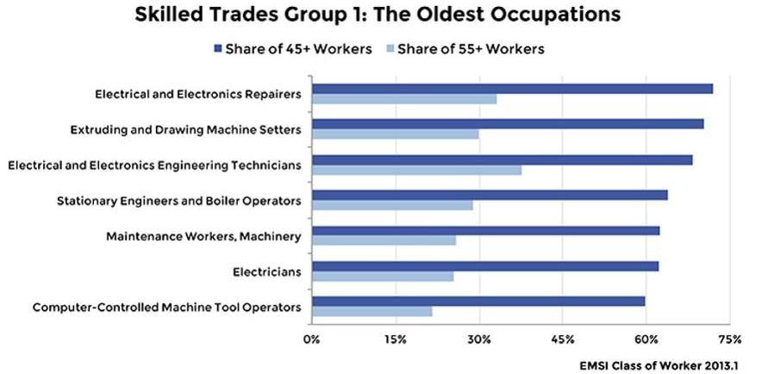
Notes:
The oldest skills group in the U.S. is electrical and electronics engineering technicians, with 38 percent of jobs held by workers 55 years and older. Meanwhile, a third of electrical and electronics repairers are at least 55, while 72 percent are 45 years and older.
We’ve broken the 21 occupations into three groups – the oldest, the not-so-old, and the youngest. Group 1 encompasses occupations where at least 60 percent of the workforce is 45-plus years old. Included in the list are electricians, by far the largest of all the skilled trades with more than 600,000 jobs in the U.S.

Slide 36
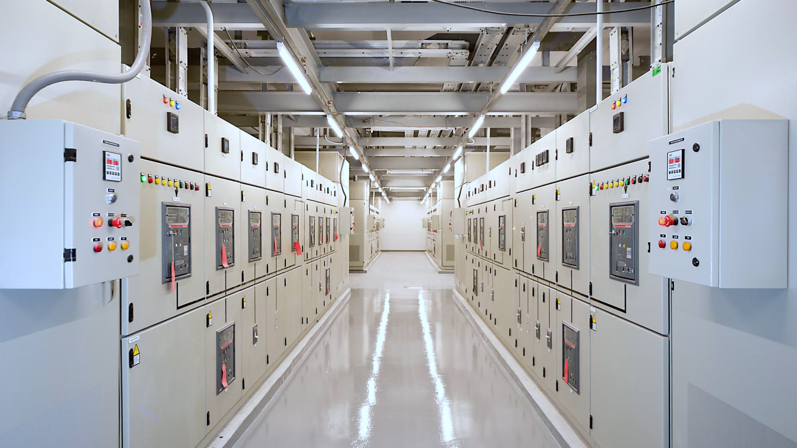

Manhour Analysis for Data Center
Data Center currently has 250 Critical Electrical Assets that are inspected annually
(Due to intrusive nature of the CBM inspection).
The CBM inspections are currently completed
“ENERGIZED”
in full compliance with NFPA 70E & 70B.
Inspection is completed by 2 Plant Electricians (required for panel removal) & 1 Contract CBM Company.
Annual CBM Inspections currently take approximately 250 hours.

Slide 37
Analysis of Energized Survey Removing Panels
Operation | Man-Hours | Total Man-Hours
RCM Engineer PPE Suit-up | 0.5 | 42.0
Electrician PPE Suit-up | 0.5 | 84.0
42 Shifts (2 Suit-ups Per Shift) Total 84 Dress Outs = |  | 126.0 Hours
Operation | Man-Hours | Total Man-Hours
Cover Removal | 0.5 | 250.0
RCM Inspection | 0.1 | 25.0
Cover Replacement | 0.5 | 250.0
RCM Engineer Waiting Time | 1.0 | 250.0
Electrician Waiting Time | 0.1 | 50.0
Manhours For Paper Mill Site Inspection = |  | 825.0 Hours
Total Manhours for Paper Mill Site Inspection = |  | 951.0 Hours

Slide 38
Operation | Man-Hours | Total Man-Hours
RCM Engineer PPE Suit-up | 0.5 | 42.0
Electrician PPE Suit-up | 0.5 | 84.0
42 Shifts (2 Suit-ups Per Shift) Total 84 Dress Outs = |  | 126.0 Hours
25.0 HOURS (2.6%) OF
PRODUCTIVE LABOR
Operation | Man-Hours | Total Man-Hours
Cover Removal | 0.5 | 250.0
RCM Inspection | 0.1 | 25.0
Cover Replacement | 0.5 | 150.0
RCM Engineer Waiting Time | 1.0 | 250.0
Electrician Waiting Time | 0.1 | 50.0
Manhours For Paper Mill Site Inspection = |  | 825.0 Hours
Total Manhours for Paper Mill Site Inspection = |  | 951.0 Hours

Slide 39
Operation | Man-Hours | Total Man-Hours
RCM Engineer PPE Suit-up | 0.5 | 42.0
Electrician PPE Suit-up | 0.5 | 84.0
21 Days (2 Suit-ups Per Day) Total 42 Dress Outs = |  | 126.0 Hours
Operation | Man-Hours | Total Man-Hours
Cover Removal | 0.5 | 250.0
RCM Inspection | 0.1 | 25.0
Cover Replacement | 0.5 | 250.0
RCM Engineer Waiting Time | 1.0 | 250.0
Electrician Waiting Time | 0.1 | 50.0
Manhours For Paper Mill Site Inspection = |  | 825.0 Hours
Total Manhours for Paper Mill Site Inspection = |  | 951.0 Hours
926.0 HOURS (97.4%) OF DANGEROUS, HIGH RISK,
UNPRODUCTIVE LABOR…

Slide 40
Operation | Man-Hours | Total Man-Hours
RCM Engineer PPE Suit-up | Nil | Nil
Electrician PPE Suit-up | Nil | Nil
1 Day, Zero Dress Outs = |  | 0 Hours
 | Man-Hours | Total Man-Hours
Cover Removal | Nil | Nil
RCM Inspection | 0.2 | 30
Cover Replacement | Nil | Nil
RCM Engineer Waiting Time | Nil | Nil
Electrician Waiting Time | Nil | Nil
Manpower For Paper Mill Site Inspection = |  | 30.0 Hours
Total Manpower for Paper Mill Site Inspection = |  | 30.0 Hours
30 HOURS
(100%) PRODUCTIVE LABOR
Analysis of Energized Survey Utilizing EMSD’s

Slide 41
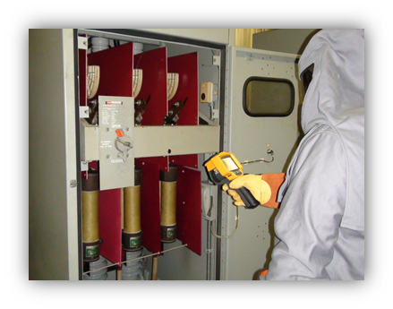
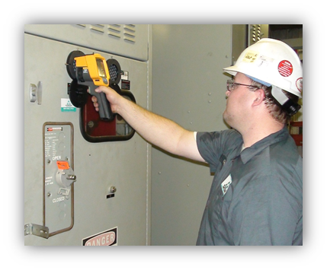
Man-hour Savings
Inspections went from taking 951 hours using a 3 person inspection team to 30 hours using one inspector.
A real-world saving of over 97.4% on the man-hours needed to complete this task.
Before
After

Slide 42



Slide 43


