Slide 1
RAMS Analysis

Slide 2
Agenda
Introduction
Vocabulary
DfR Introduction
RAM Definition
Example
Case Study
Questions

Slide 3
Introduction
Adamantios Mettas
Vice President of Business Development at HBM Prenscia.
20 years of experience in reliability tools and methods, researching, lecturing, designing, delivering and implementing Reliability and Asset Performance Management solutions worldwide.
More than 35 publications in journals and proceedings, co-authored 4 books, and trained more than 2000 engineers in reliability methods.
Directly involved as a Project Manager, Implementation Manager, and Primary Consultant/Analyst in major Design for Reliability and Asset Performance Management projects/initiatives worldwide and across different industries, including Oil & Gas, Power Generation, Automotive, Rail, Semiconductor, Defense and Aerospace, and for clients such as XEROX, DELPHI, FORD Motor Company, VOLVO Cars, Chevron, Kuwait Oil Company, Ma’aden Phosphate Company, and others.
Tearesa Wegscheid
Sr. Reliability Solution Consultant at HBM Prenscia.
Involved in product engineering for over 33 years, including statistical analysis, reliability testing and data analysis, and quality control.
Provided training Certified Reliability/Quality Engineering exam, the use of FMEA in the product development cycle, quality control techniques, life data analysis, and Design for Reliability.
B.S. from Western Michigan University in Experimental Psychology and Computer Science. M.S. in Computer Science, Educational Leadership and Manufacturing & Industrial Engineering.
Certified Reliability Engineer (ASQ) and a Certified Quality Engineer (ASQ). She is also a Certified Reliability Professional (CRP).

Slide 4
Introduction (cont’d)
4.0
Connectivity
IoT, PDM, EAM
3.0
Integration
Combine analysis to develop models
Capability
2.0
Computerization
Software to assist
In data analysis
1.0
Tools
FMEA
Weibull
1990
2000
2010
2020
Determine the data (data sources) needed to construct a RAM analysis during product development
Notes:
Predictive maintenance:
Increase asset availability
Reduce maintenance cost – over-maintenance
Improve personnel safety
Offset the added costs
AI – attempt to understand and replicate human cognitive functions
ML – machine learning - ability of a computer program to perform tasks for which it has not be explicitly programmed (subset of AI)
Huge increase in computer power have made some theoretical approaches practical, but only recently

Slide 5
Vocabulary
CMMS – Computerized Maintenance Management System
DfR – Design for Reliability
EAM – Enterprise Asset Management
IoT – Internet of Things
LCC – Life Cycle Cost
MIL – Military Handbook 217
MTBF – Mean Time Between Failure
MTTR – Mean Time to Repair
OEM – Original Equipment Manufacturer
PDM – Product Data Management
RAM – Reliability, Availability and Maintainability
RBD – Reliability Block Diagram

Slide 6
DfR Introduction
Survey was conducted by ReliaSoft – 950 responders
Select the reliability and/or quality improvement programs that are currently implemented by your company
Survey Results
Top Ranked Improvement Programs
Rank | Program
1 | Design for Reliability (DFR)
2 | Lean Six Sigma
3 | Reliability Centered Maintenance (RCM)
4 | Design for Six Sigma
5 | Process Reliability (includes Overall Equipment Effectiveness)
6 | Risk Based Inspection (RBI)
7 | Maintenance Steering Group Version 3 (MSG-3)

Slide 7
DfR Introduction (cont’d)
Reliability Competency Deployment
What best describes the deployment of reliability in your company?
Best Practice
  Create a reliability function within the organization, supported with business processes and procedures for achieving reliability standards
Survey Results
  60% of Best in Class organizations have a formal reliability function and business procedures

Slide 8


DfR Introduction (cont’d)
STRATEGY
3 important statements summarize the best practice reliability philosophy of successful companies:
Reliability should be quantified using the best available science-based methods
Knowing how to calculate reliability is important, but knowing how to achieve reliability is equally, if not more, important
Reliability practices must begin early in the design process and must be well integrated into the overall asset life cycle
Understanding when, what and where to use the wide variety of reliability engineering tools will help to achieve the organization’s reliability mission

Slide 9
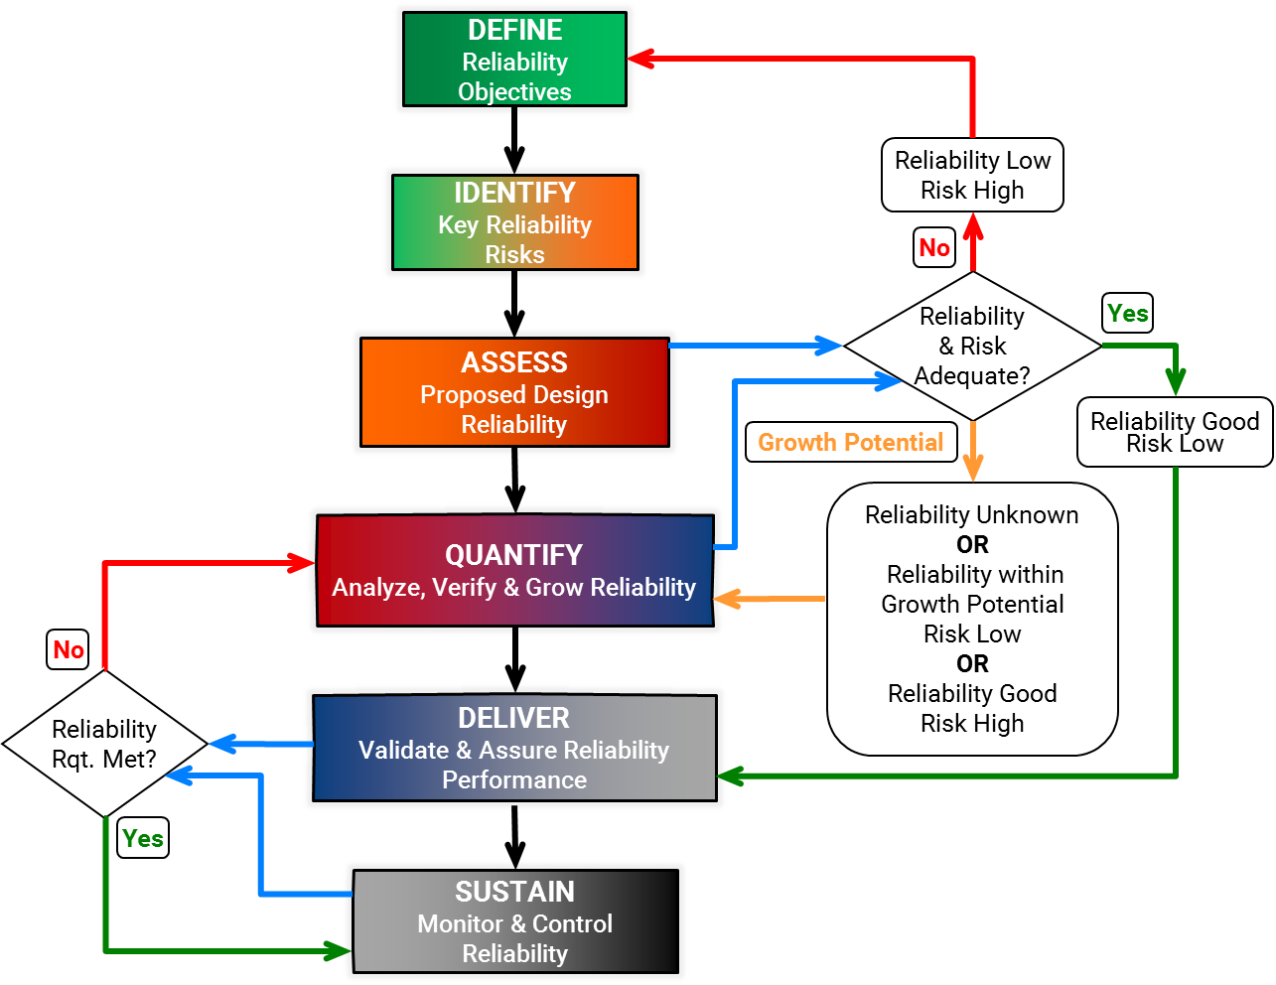
DFR Process

Slide 10
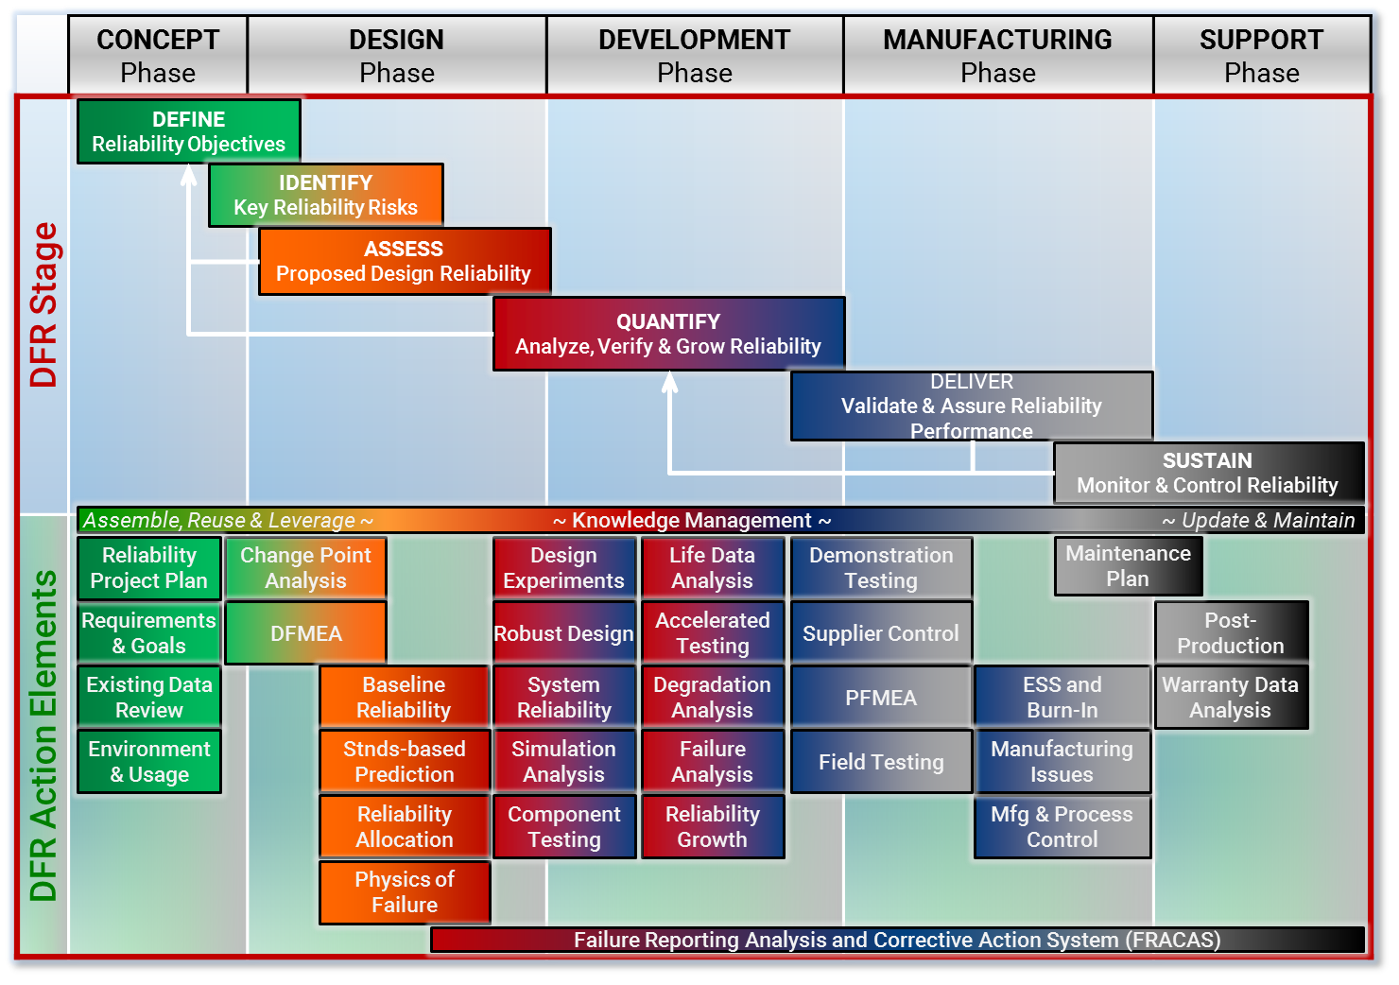
DFR Process (cont’d)

Slide 11

RAM Introduction
Objectives
Optimize Maintenance Strategy & Plans
Reduce Downtime & Maintenance Costs
Spare Parts Forecasting
Identify Design Weaknesses
Compute Reliability
Optimize production & Quality
Increase Safety
Life Cycle Cost Analysis

Slide 12




RAM Analysis – What is RAM?
RAM refers to Reliability, Availability and Maintainability
Reliability defines the failure frequency and determines the uptime patterns
Reliability is the probability of the equipment performing its intended function for a specified period of time
Example: the pump has a 95% probability of running after 8760 hours of use.
Availability is the percentage of uptime over a given operating time
It is determined by operational performance, equipment reliability and maintainability
Maintainability describes how soon an item or system can be repaired, which determines the downtime distributions based on failure mode

Slide 13
RAM Analysis Goals
The main objectives of RAM are to increase system productivity, increase the overall availability as well as reduce the total life cycle costs
  Design optimization
  Identify the weakest link in the existing system with statistical proof
  Verification of reliability / availability requirements
  Forecasting production / availability
  Maintenance optimization
    Resource utilization
    Scheduling
    Spare part strategy
Notes:
Lean out Text. Divide into t20-three slides

Slide 14
Example – Pipeline
Consider a pipeline made up of 4 pipes
Pumping station A uses 3 pumps to pump oil (through the 4 pipes) to pumping station B
Pumping station B has 4 assisting pumps to raise the oil over a mountain and deliver it to a holding tank at station C
C
A
B
B
B
B
B

Slide 15
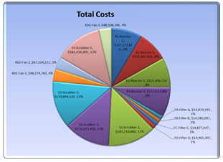
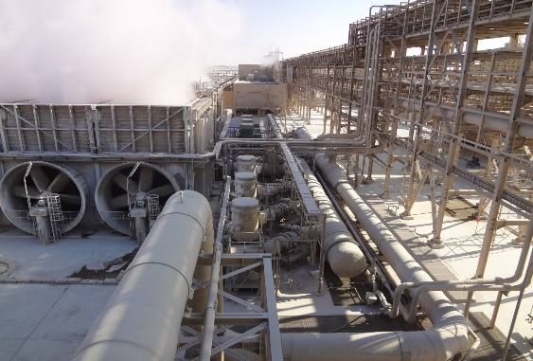
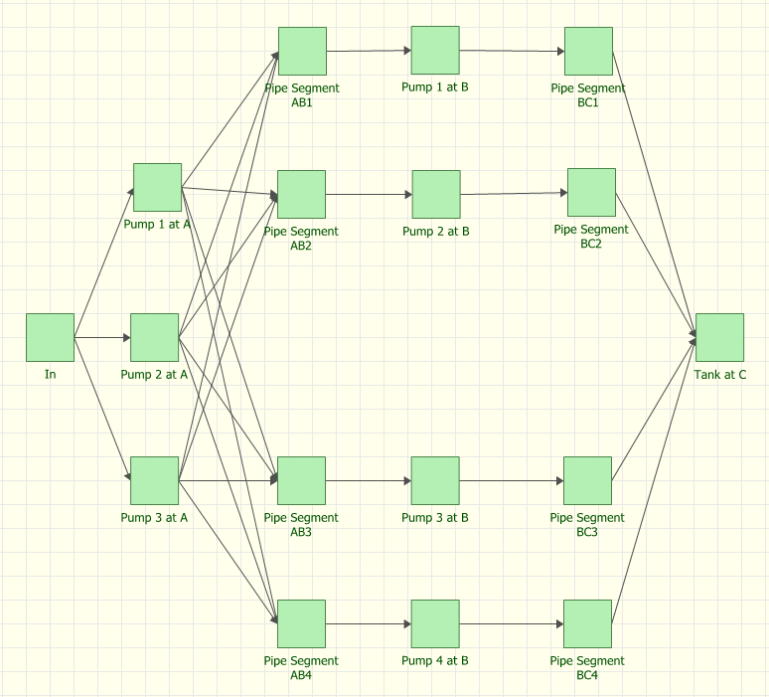
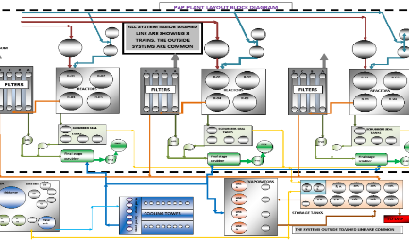
Example – Pipeline (cont’d)
Problem
Solution
Value
  High maintenance cost due to Pump Life.
  Station opened 2 years ago
  Pumps Replaced as needed
  Pipes Repaired, not replaced
  Management needs justification for purchasing pricier pumps
  Implemented an asset reliability monitoring system
  Implemented a root cause analysis process and system
  Trained engineers in methods and software
  Connected to CMMS
  Modelled process including reliability and maintainability of equipment; based on historical data (observed failures)
  What-if analysis, sensitivity analysis, and large changes in a system without real world costs.

Slide 16
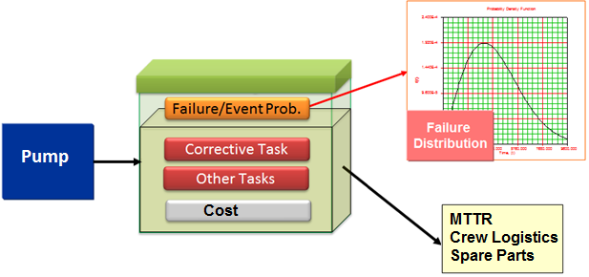
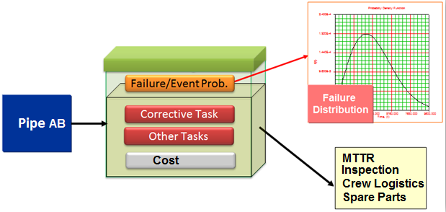
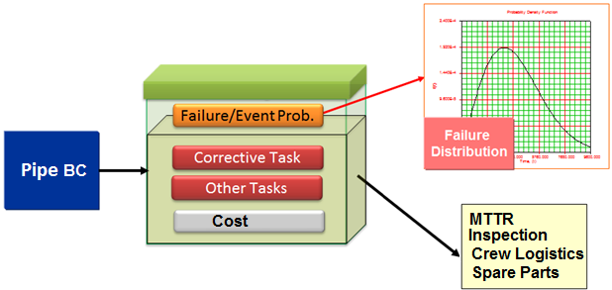
Example – Pipeline (cont’d)

Slide 17
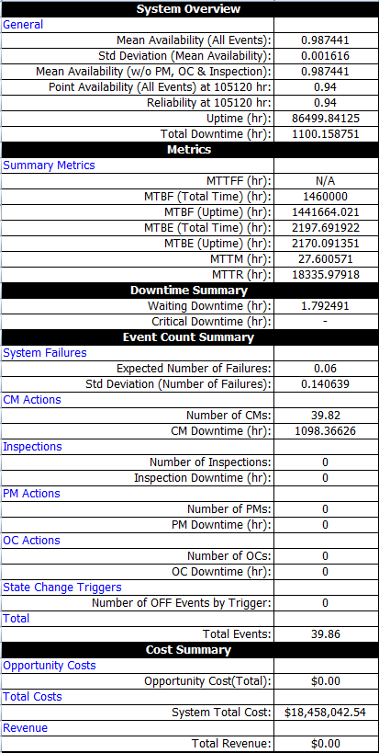
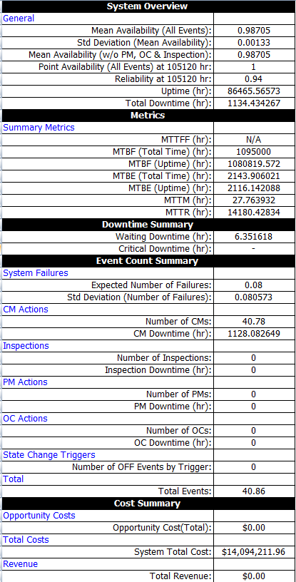
Example – Pipeline (cont’d)
Improved Pump
Last 5x longer
Cost 3x ?

Slide 18
RAM Analysis – Inputs and Outputs
Inputs | Source | Outputs | Supports | Benefits
Failure Distribution Repair Distribution Costs Throughput | OEM Historical Expert Opinion Generic Failure Data (e.g. MIL 217, etc.) | Availability Reliability MTBF Downtime Number of Failures Throughput Costs | Design LCC Safety Analysis Scenario investigation | Design capability Identify Process Bottlenecks Design Predictions (Availability, Costs, Production, etc.) LCC Design Improvement

Slide 19
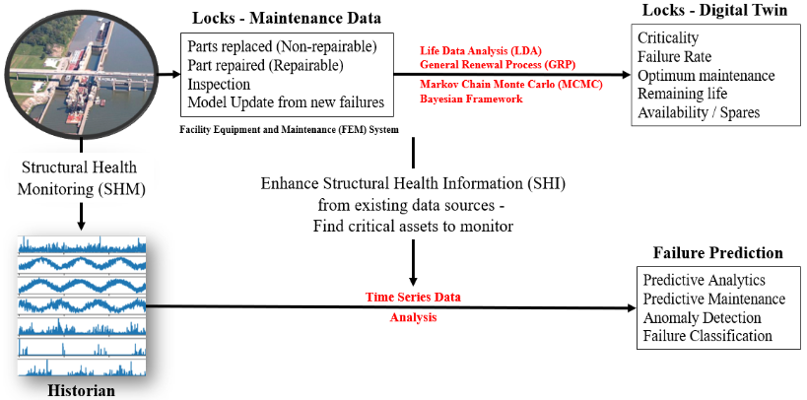
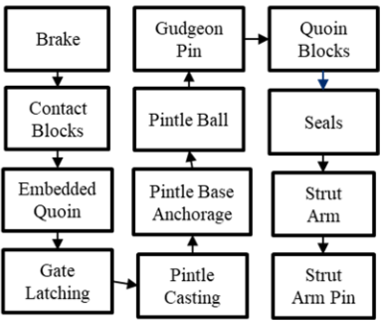
Case Study 1 – Navigation Locks Model

Slide 20
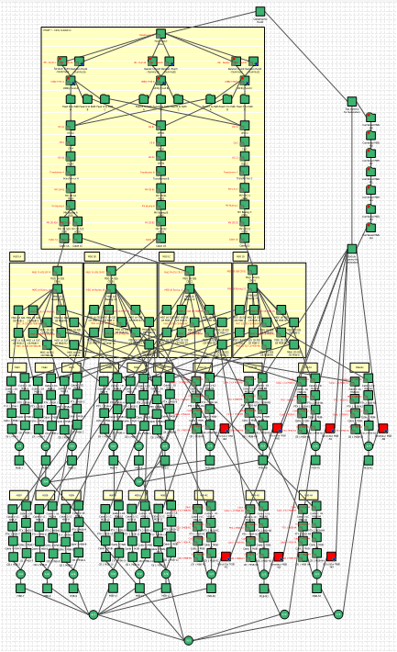
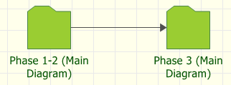
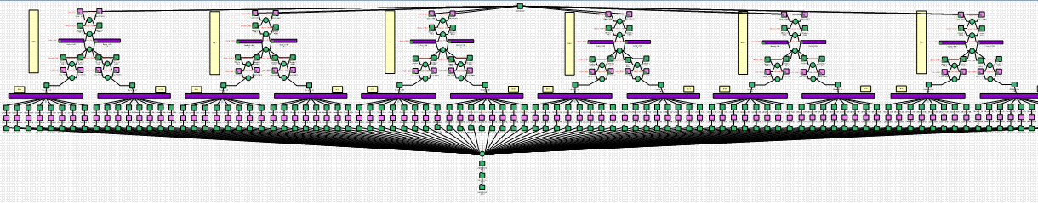
Case Study 2 – Network Model
Model the whole system with two subdiagrams connected in series
Subdiagram 1: Represents the full model of Phase 1&2
Subdiagram 2: Represents the full model of Phase 3

Slide 21
Case Study 2 – Network Model (cont’d)

Slide 22
Case Study 2 – Network Model (cont’d)

Slide 23
Case Study 3 – Asset Model
Fresh Water Intake System
System Overview
General
Mean Availability (All Events): | 0.995643
Mean Availability (w/o PM, OC & Inspection): | 0.995643
Reliability at 43800 Hr: | 0.021
Uptime (Hr): | 43609.16347
Total Downtime (Hr): | 190.83653
Metrics
Summary Metrics
MTTFF (Hr): | 10687.60362
MTBF (Total Time) (Hr): | 11187.73946
Event Count Summary
System Failures
Expected Number of Failures: | 3.915
CM Actions
Number of CMs: | 3.915
CM Downtime (Hr): | 190.83653
System Overview
General
Mean Availability (All Events): | 0.997784
Mean Availability (w/o PM, OC & Inspection): | 0.997784
Reliability at 43800 Hr: | 0.318
Uptime (Hr): | 43702.94023
Total Downtime (Hr): | 97.059774
Metrics
Summary Metrics
MTTFF (Hr): | 18382.38336
MTBF (Total Time) (Hr): | 37726.09819
Event Count Summary
System Failures
Expected Number of Failures: | 1.161
CM Actions
Number of CMs: | 1.161
CM Downtime (Hr): | 97.059774

Slide 24





Case Study 3 – Asset Model (cont’d)
FMEA identified lack of nearby fresh water supply as cause of unnecessary downtime
Added a standby pump
Increased capacity of Feed Pumps
49% decrease in Total Downtime
69% decrease in Plant Stoppages

Slide 25
Thank you for your attention
Questions

