Slide 1
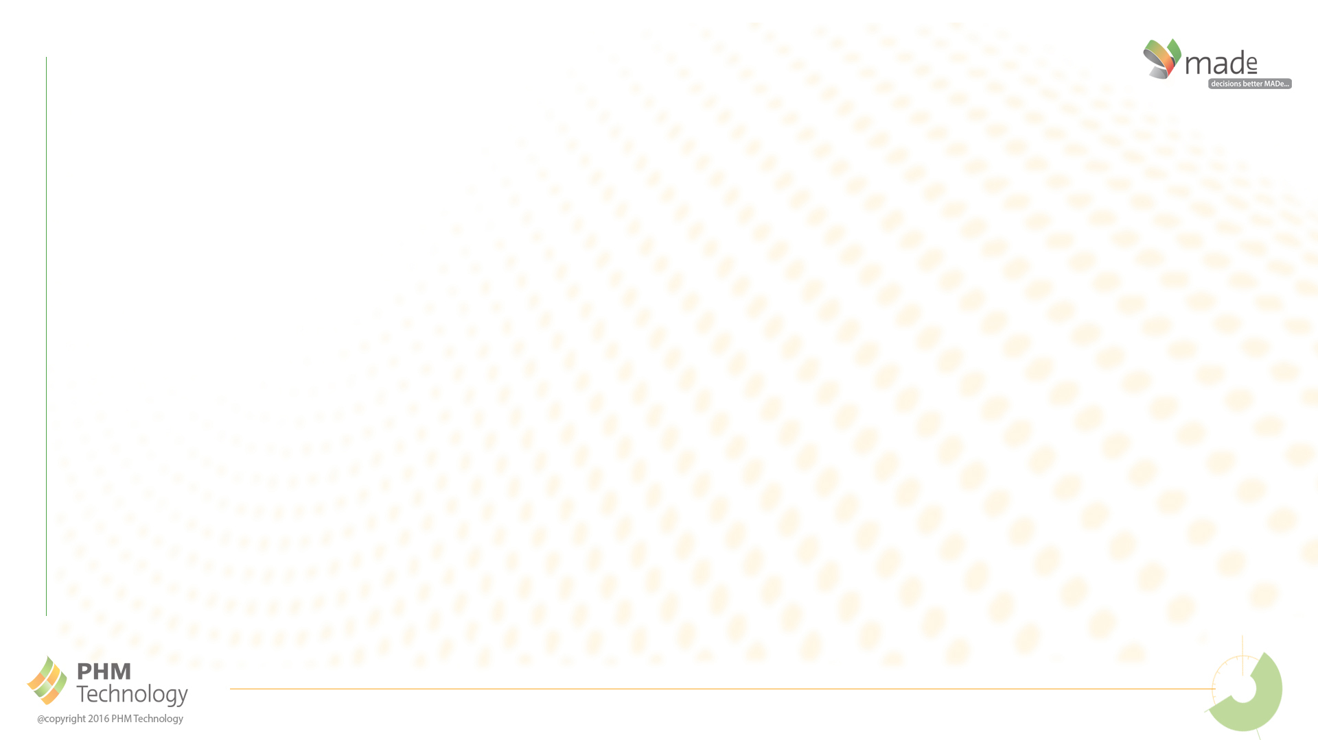
Autonomous FRACAS
Standardizing failure reporting from sensors and maintainers to achieve the Digital Twin for Maintenance

Slide 2
Presentation Summary
Problem Statement – FRACAS is required for complex, safety critical systems that aligns with the digital paradigm (model-based analysis)
Solution Constraints – data quality from operations inconsistent and
Solution Requirements – how to rapidly identify key degraders then optimize the associated maintenance to achieve availability targets?
Case Study – implement model-based solution to integrate required analyses using standardized taxonomies and workflows, define / optimize maintenance approach & frequency using RCM / B-RCM
Project outcomes – increased availability, optimized maintenance budget, change to the failure reporting processes
Implications for NASA – objective assessment of system performance and consistent method for determining revised maintenance; benchmarking (across fleets / sites); knowledge capture & reuse
Failure Analysis
(AVE 850 failure reports pm across 14 vessels)
Without standardized failure reporting:
5 weeks to review / action
With standardized failure reporting:
<2 days to review / action
Process Improvement = 92% reduction in processing of failure reports

Slide 3

What questions does a FRACAS answer?
Can we reduce the cost of ownership
for our systems?
Can we improve operational availability?
Do we get the right field data we need to
Identify the optimal maintenance approach?
How to ensure we identify, analyze and mitigate all failures that are occurring?
Is there technology that can improve
/ automate the FRACAS process?
Can CBM improve the Operational
Availability of the system?
Is there a business case to support a new FRACAS solution?
How to capture / transfer system knowledge and lessons learned for long-life programs?

Slide 4
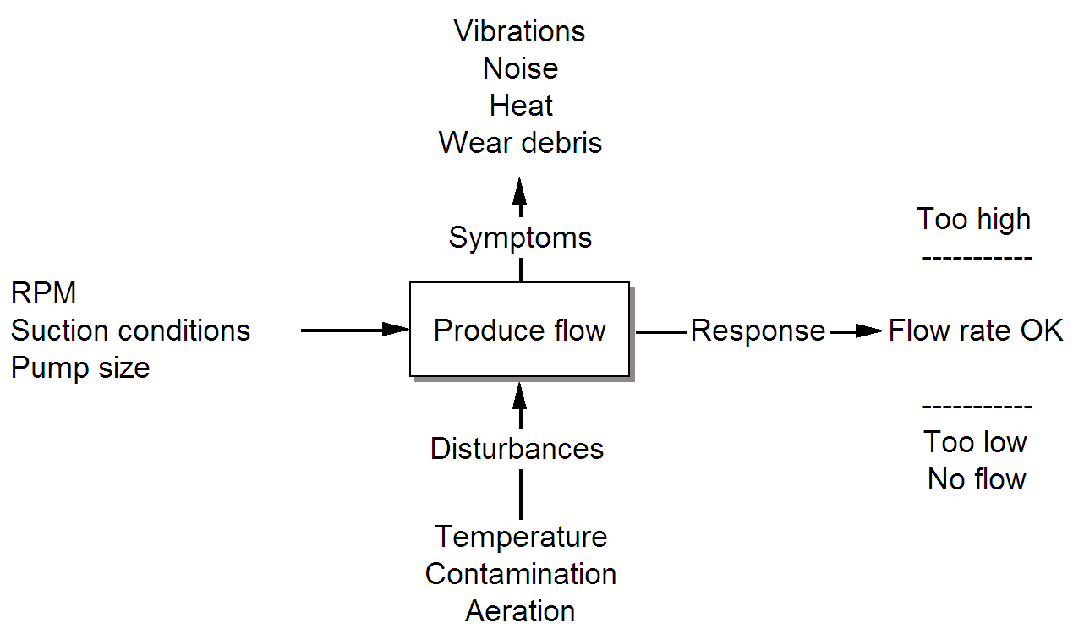
Solution Constraints
FRACAS systems have been in operation since 1985 (US Navy), but there are systemic issues that limit their potential benefit, including:
inaccurate failure / defect reporting by maintainers (e.g. ‘broken’)
lack of synchronization of failure data sourced from maintainers and sensors
lack of synchronization of failure descriptions from operations with safety / reliability analysis performed during design / certification
no direct integration of data from failure reports with analysis tools (data needs to be migrated & manually ‘interpreted’ and analysed)
no consistency in the analyses and processes used to interpret the operational data and recommend updated maintenance practices
lack of automation / consistency in the failure analysis required
many FRACAS systems are better categorized as ‘incident reporting systems’
* [US DOD DTE 2008]

Slide 5
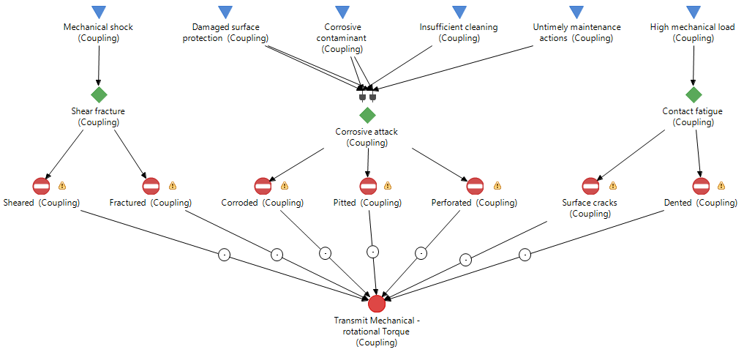
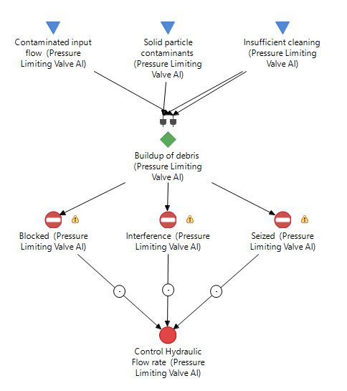
Solution Requirements
In order to improve FRACAS solutions in the context of these constraints, it requires the process and tools to:
consistently describe and categorize reported failures / defects
identify the technical risks that are impacting availability / life-cycle cost
develop an appropriate risk mitigation (maintenance approach) based on the root cause of the failure / defect
monitor / measure the effectiveness of the risk mitigation activities
continuously iterate this process based on operational outcomes
The solution should:
consistently provide the required data to inform maintenance decisions
enable the Asset Owner to be a ‘Smarter Customer’
be cost-effective for the Asset Owner

Slide 6
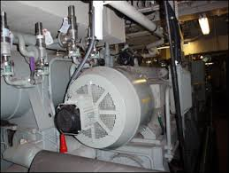
CASE STUDY: Overview
Summary
Contractor had a long-term contract to provide maintenance and logistics to sustain a class of navy ships at an agreed level of Operational availability (Readiness)
The platform was not meeting the contracted availability target and was regularly exceeding its allotted maintenance budgets – impacting on Fleet Readiness metrics
Contractor was not the OEM that produced the vessel and did not have access to all of the original design documentation (only recommended maintenance plans)
Vessel was used both more frequently and in an environment that exceeded the original design specifications (# sea days, prevailing sea state conditions)
Contractor required a solution to identify alternative maintenance approaches to improve the availability of the platform, in the context of its usage (mission profile) and operating environment.

Slide 7
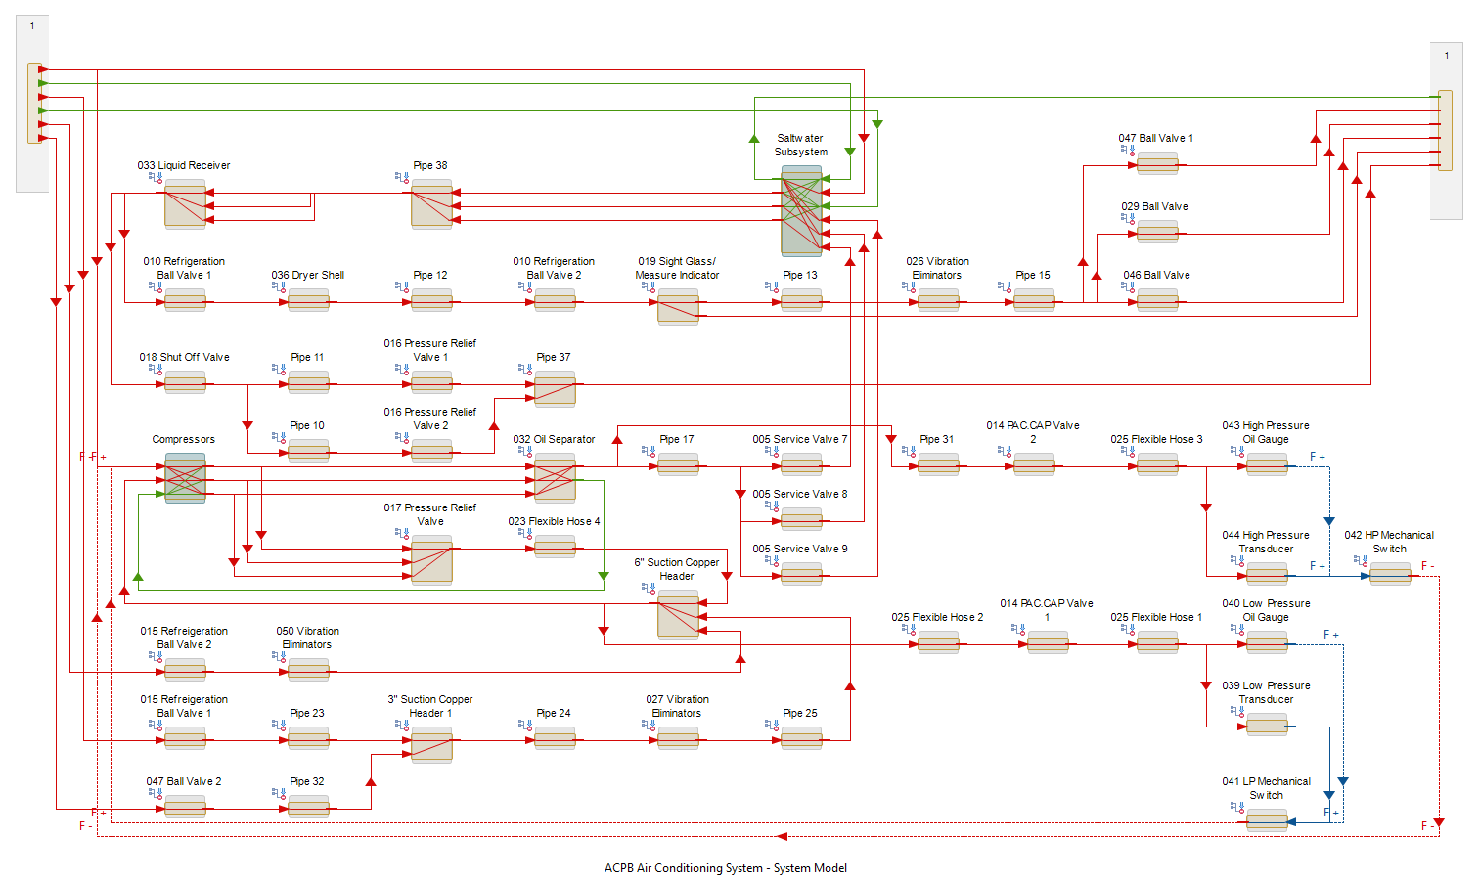
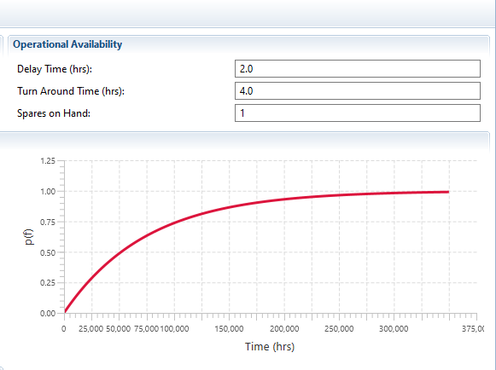

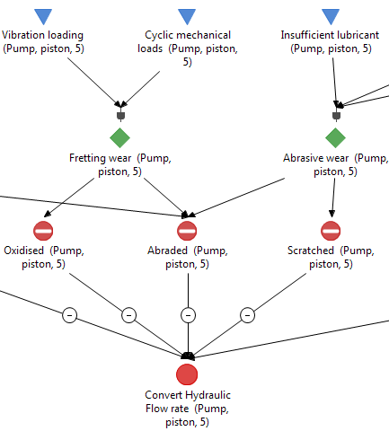
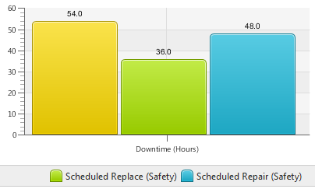
CASE STUDY: Process
Generate a model of the vessel at the platform / system level
Analyze failure data & Work Orders [8 years operations] to categorize failures by system, component and failure type and calculate failure rates (issues: productivity in a manual process; data integrity: >65% of failures were based on “undetermined” causes of failure)
Generate detailed model of the sub-system where significant number of failures occurred, and input calculated ‘operational’ failure rates (from Step 2)
Identify key System Availability Degraders (SADs), Reliability <95%
Develop Root Cause Analysis for SADs (Failure Diagram)
Conduct Maintenance Analysis (Back-fit RCM where existing maintenance is prescribed, RCM where no maintenance task is associated with the failure) including cost comparison over expected platform life
Update maintenance plan with revised maintenance (approach, frequency, procedure, etc.)

Slide 8
CASE STUDY: Results
Outcomes
Accelerated process for identifying Poor Performers and recommending changes to the approach / periodicity of maintenance (92% reduction in engineering resource required)
Increased Readiness (Operational Availability) of the system by (~300% improvement: 864 MTBF vs 288 MTBF)
Reduced sustainment costs for the platform (ROI >3)
Analysis solution to model the expected impact of changes to mission profile / operating environment on maintenance costs
Knowledge base of failures and maintenance actions that the Contractor can reuse across the life of the platform / contract
A means of objectively validating and communicating their analysis to the customer
KEY BENEFIT:
Failure Analysis Process
(AVE 850 defect reports per month across 14 vessels)
Without MADe: 5 weeks to review / action
With MADe: <2 days to review / action
= 92% increase in analysis / review efficiency

Slide 9
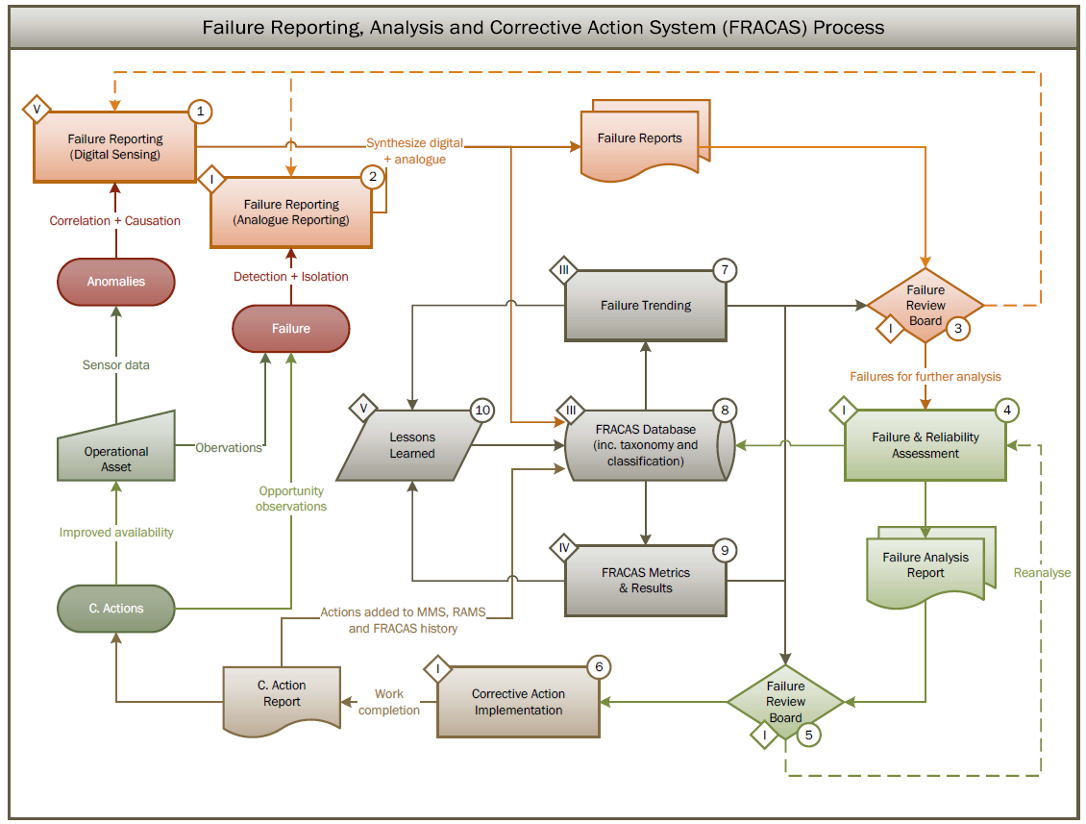
Autonomous FRACAS – Process Overview

Slide 10
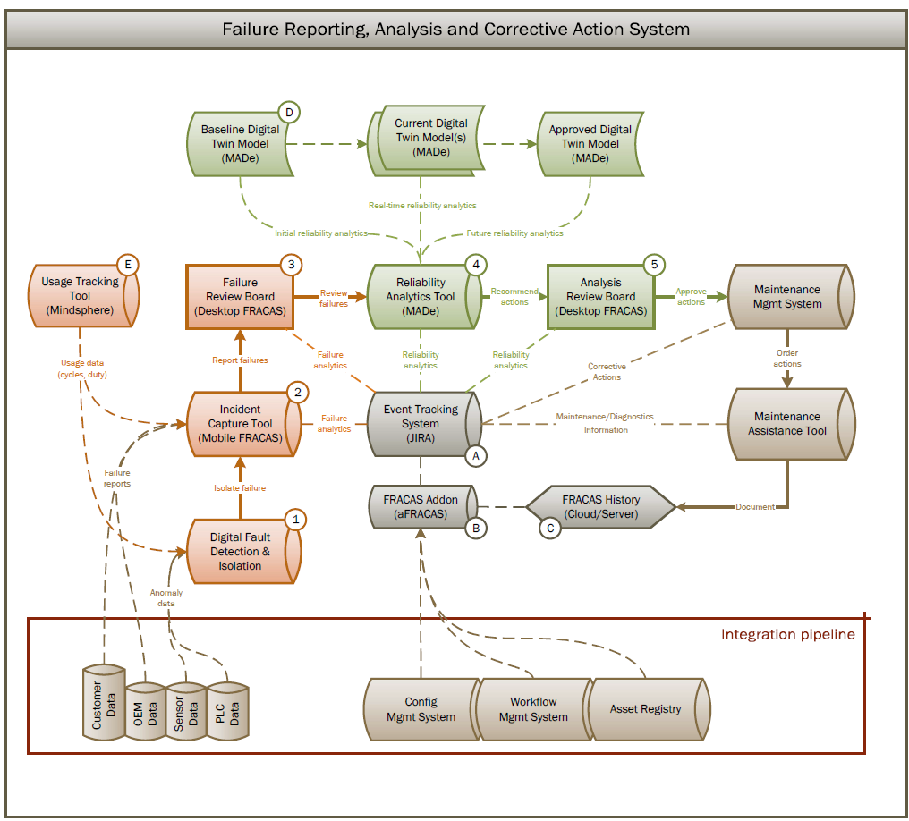
Autonomous FRACAS – System Overview

Slide 11
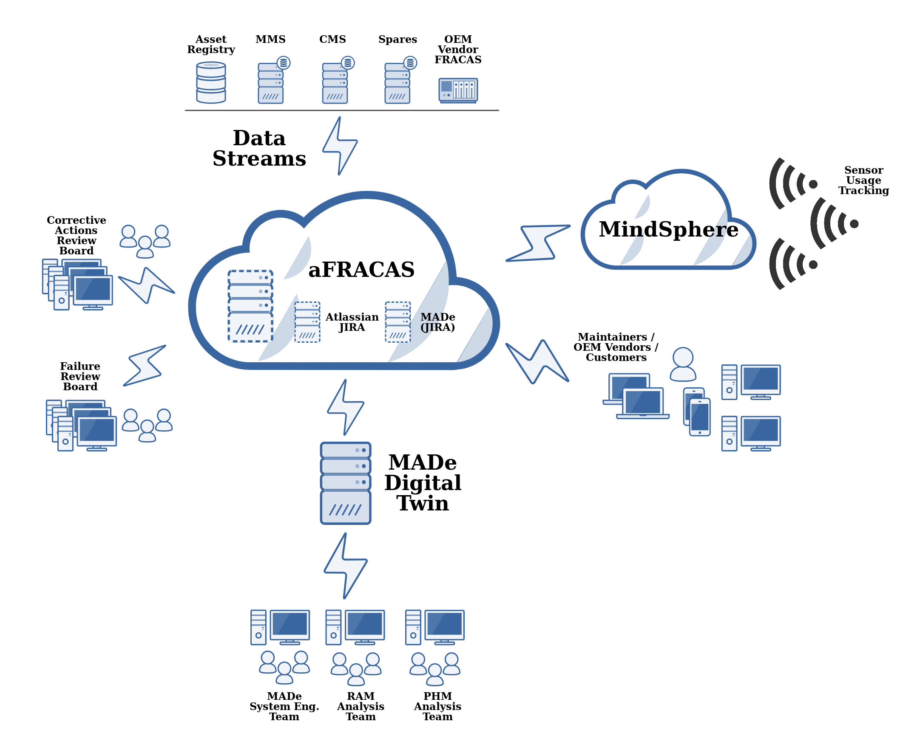
Autonomous FRACAS - Architecture

Slide 12
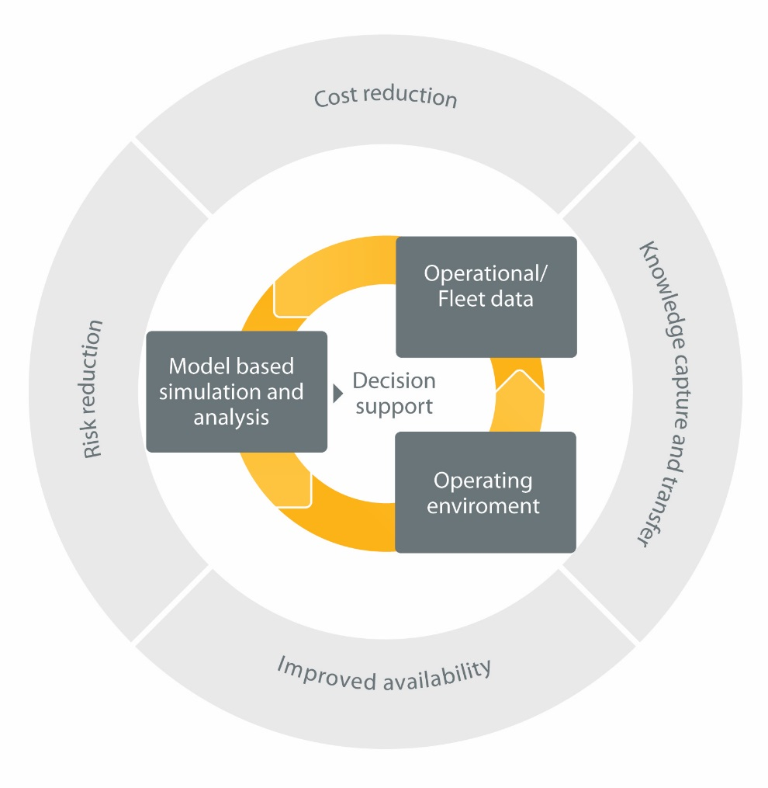
Implications for NASA
An Autonomous FRACAS solution provides NASA with the following benefits:
Digitization– a Digital Twin for Maintenance that uses both manual and digital failure reporting to update system parameters
Consistency – data structures & workflows for failure / defect reports aligned with analyses performed during design / certification
Traceability of analysis to support maintenance recommendations
Integrated Solution – common source of truth across a project
Data visualization enables knowledge capture / transfer
Result: integrated, automated analysis solution that enables trade studies using operational data to optimise Availability and Cost of Ownership in a traceable process that ensures knowledge transfer

