Slide 1

Modelling for Maintenance Planning and Cost Estimation
Identifying and mitigating key system availability degraders in
legacy systems using a model-based analysis solution

Slide 2
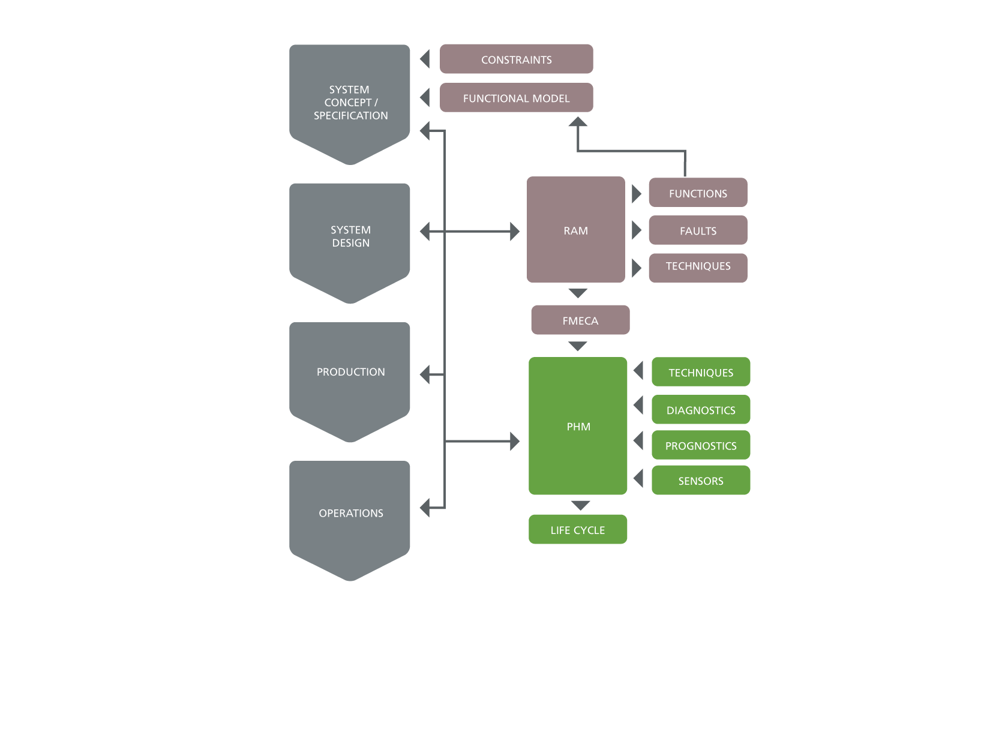
Presentation Summary
Problem Statement – legacy system not meeting operational availability targets with existing maintenance budget
Solution Constraints – reliability is “designed in”, limited access to design data for legacy systems, usage variations impact maintenance
Solution Requirements – how to rapidly identify key degraders then optimize the associated maintenance to achieve availability targets?
Process Overview – what are the steps required to optimize maintenance?
Case Study – implement model-based analysis using standardized taxonomies and workflows to define / optimize maintenance approach
Project outcomes – change to the failure reporting processes lead to increased availability and reduced maintenance load / budget
Implications for NASA – objective assessment of system performance and consistent method for determining revised maintenance; benchmarking (across fleets / sites); knowledge capture & reuse

Slide 3

What do we mean by Maintenance Planning?
How can we reduce the cost of ownership
for our systems?
Can we improve operational availability?
How to identify the optimal maintenance approach based on Configuration / Role / Environment?
How to ensure we identify, analyze and mitigate all engineering risks?
What technology can improve / automate maintenance analyses?
How can we use operating data to improve performance? (Predictive Maintenance)
What is the business case to support additional maintenance planning analysis?
How to capture / transfer system knowledge and lessons learned for long-life programs?

Slide 4
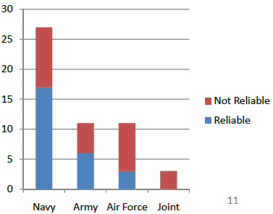
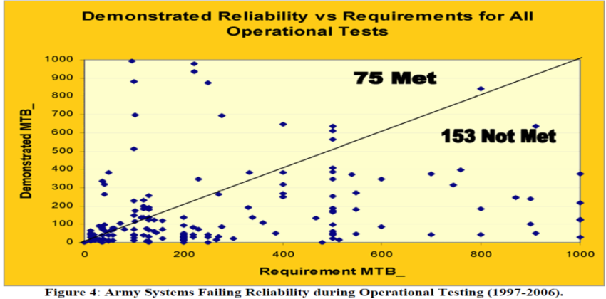
Solution Constraints
Reliability
The US DoD found that 90% of sustainment budgets are directly correlated with system reliability.* Does a system design always achieve the reliability expected by the designer or the owner?
Potential variance arises from engineering related factors, including:
  quality of the analysis / data used in the design process
  inherent reliability of components / sub-systems
  specific & combined operational usage profiles
  specific & combined operating environments
  configuration changes (modifications/upgrades)
  Access to Data
  Was the original design data acquired? (FMECA / RCM / RBD / etc.)
  What is the basis for the OEM maintenance recommendations?
  Usage Variations (Mission Profile)
  Historical performance comparisons and design based analysis provide a baseline to identify an appropriate maintenance approach – but this should be updated based on operational performance data (incl. environment).
Source: US Army Systems Failing Reliability during OTE (1997-2006)
* [US DOD DTE 2008]

Slide 5
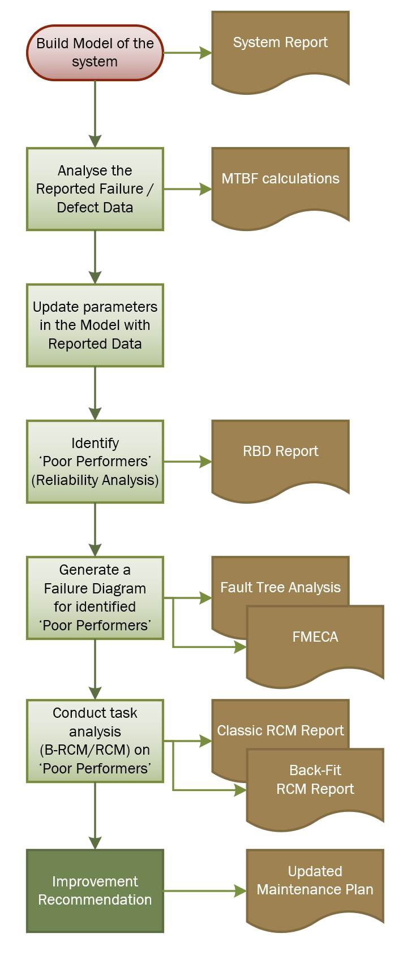
Solution Requirements
In order to improve availability of legacy systems in the context of these constraints, a process and integrated tools are required to:
collect, interpret and collate all available data on reported failures / defects
identify the technical risks that impact availability / life-cycle cost
analyse the critical risks to understand their root cause
develop an appropriate risk mitigation (maintenance approach)
monitor / measure the effectiveness of the risk mitigation activities
continuously iterate this process based on operational outcomes
The solution should:
consistently provide the required data to inform maintenance decisions
enable the Asset Owner to be a ‘Smarter Customer’
be cost-effective for the Asset Owner

Slide 6
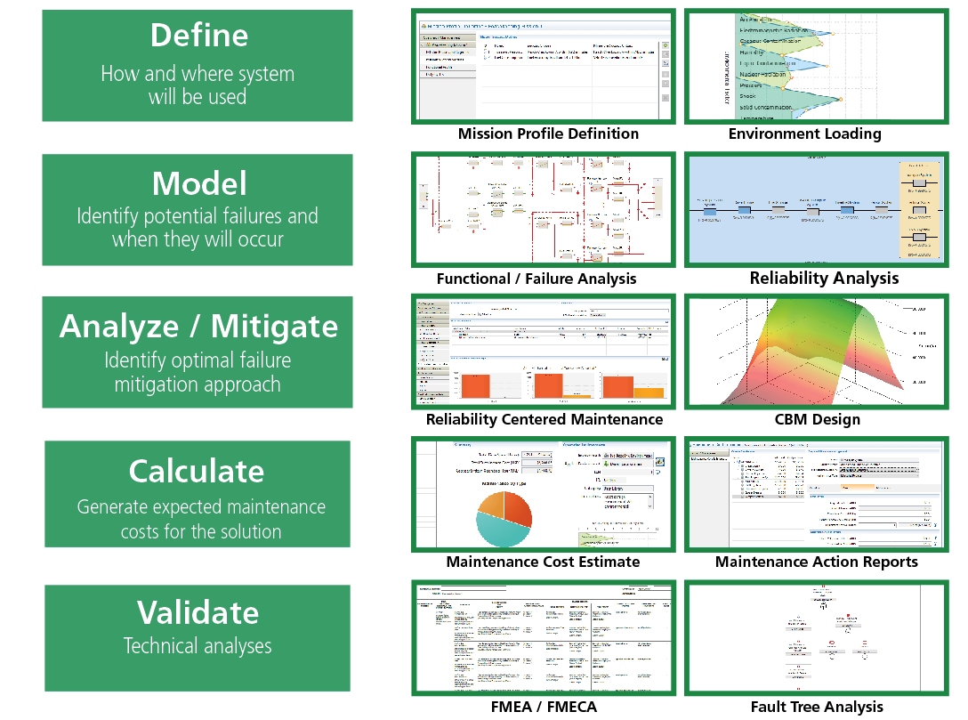
Maintenance Optimization: Process Overview

Slide 7
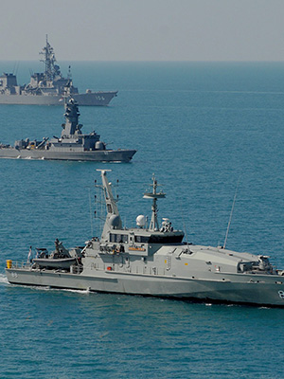
CASE STUDY: Overview
Summary
Contractor had a long-term contract to provide maintenance and logistics to sustain a class of navy ships at an agreed level of Operational availability (Readiness)
The platform was not meeting the contracted availability target and was regularly exceeding its allotted maintenance budgets – impacting on Fleet Readiness metrics
Contractor was not the OEM that produced the vessel and did not have access to all of the original design documentation (only recommended maintenance plans)
Vessel was used both more frequently and in an environment that exceeded the original design specifications (# sea days, prevailing sea state conditions)
Contractor required a solution to identify alternative maintenance approaches to improve the availability of the platform, in the context of its usage (mission profile) and operating environment.

Slide 8
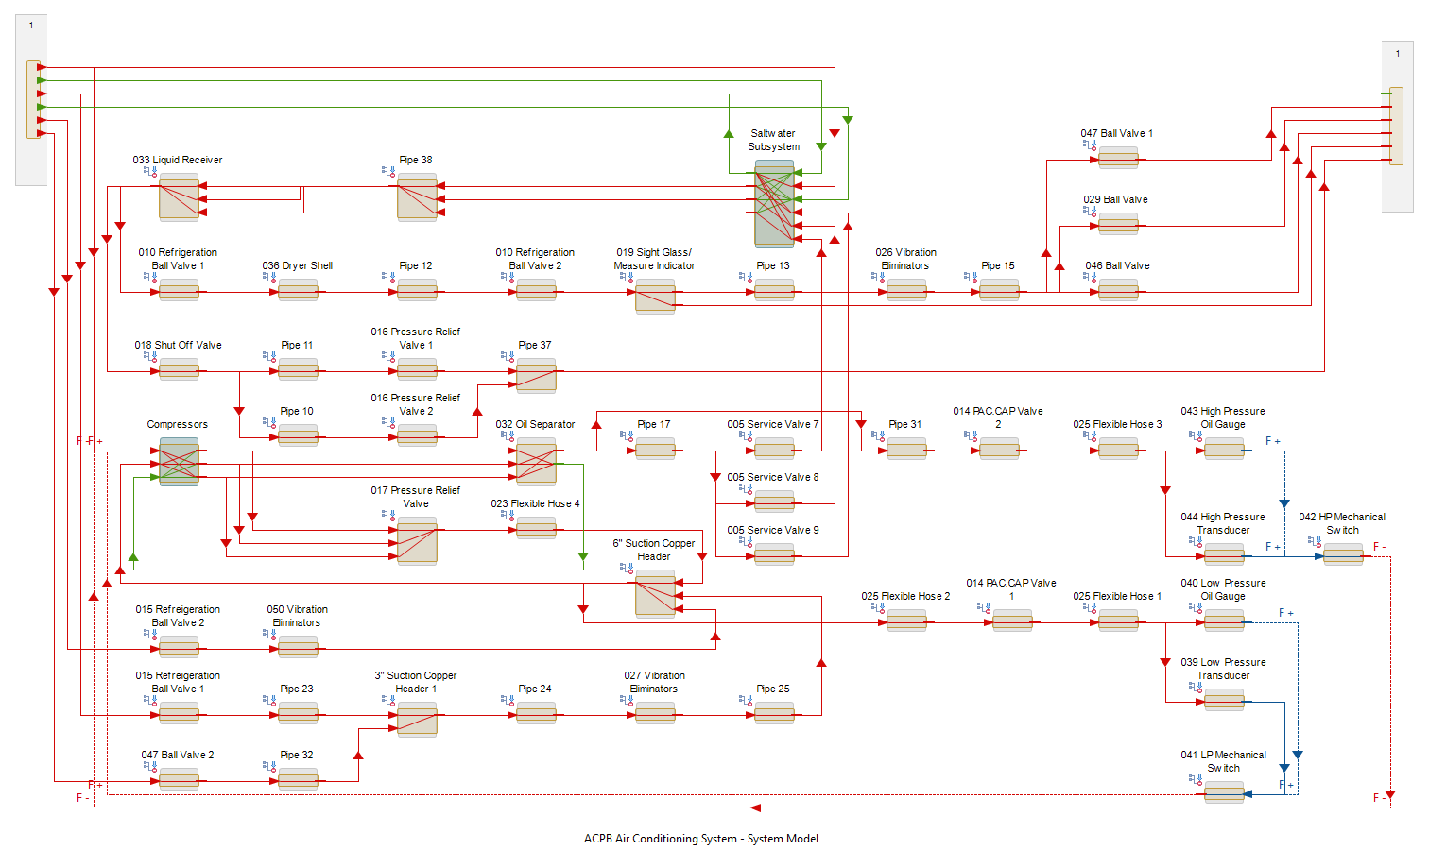
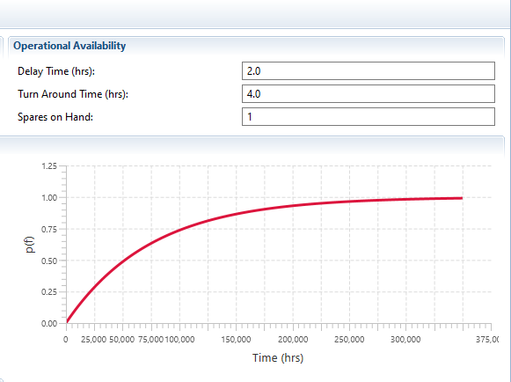

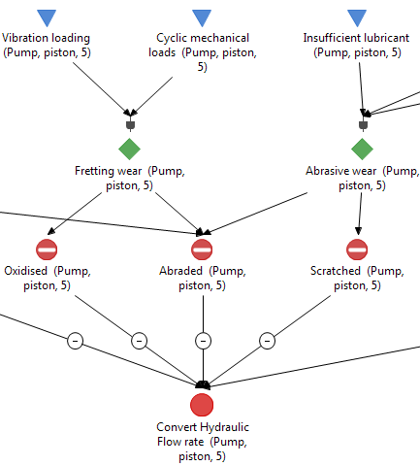
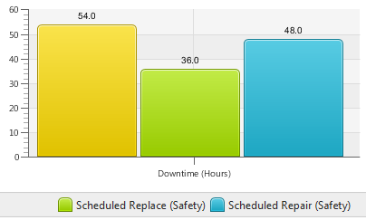
CASE STUDY: Process
Generate a model of the vessel at the platform / system level
Analyze failure data & Work Orders [8 years operations] to categorize failures by system, component and failure type and calculate failure rates (issues: productivity in a manual process; data integrity: >65% of failures were based on “undetermined” causes of failure)
Generate detailed model of the sub-system where significant number of failures occurred, and input calculated ‘operational’ failure rates (from Step 2)
Identify key System Availability Degraders (SADs), Reliability <95%
Develop Root Cause Analysis for SADs (Failure Diagram)
Conduct Maintenance Analysis (Back-fit RCM where existing maintenance is prescribed, RCM where no maintenance task is associated with the failure) including cost comparison over expected platform life
Update maintenance plan with revised maintenance (approach, frequency, procedure, etc.)

Slide 9
CASE STUDY: Results
Outcomes
Gap analysis / validation of OEM maintenance recommendations based on operational data
Increased Readiness (Operational Availability) of the system by (~300% improvement)
Reduced sustainment costs for the platform
Analysis solution to model the expected impact of changes to mission profile / operating environment on maintenance costs
Knowledge base of failures and maintenance actions that the Contractor can reuse across the life of the platform / contract
A means of objectively validating and communicating their analysis to the customer
KEY BENEFIT:
System Availability
(Based on typical Mission Profile)
Without MADe: 288 MTBF
With MADe: 864 MTBF
= 300% improvement in Availability

Slide 10
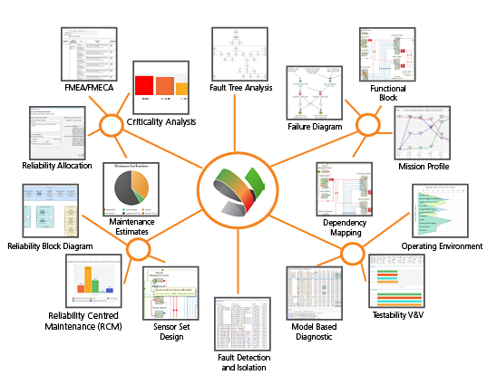
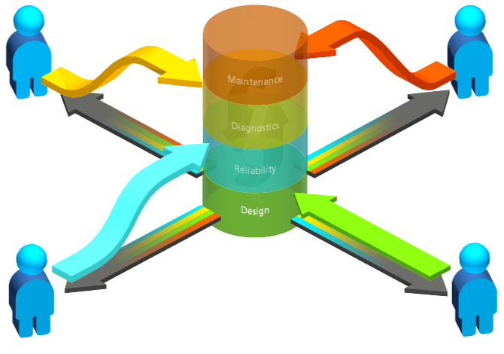
Implications for NASA
A model-based maintenance planning and analysis solution provides NASA with the following benefits:
Digitization– a Digital Twin for Maintenance: generating automated analyses – not authoring or manually analyzing data
Consistency – defined data structures & workflows for failure / defect reports and maintenance recommendations
Traceability of analysis to support maintenance recommendations
Integrated Solution – common source of truth across a project
Data visualization enables knowledge capture / transfer
Result: integrated, automated analysis solution that enables trade studies using operational data to optimise Availability and Cost of Ownership in a traceable process that ensures knowledge transfer

